Slide 1
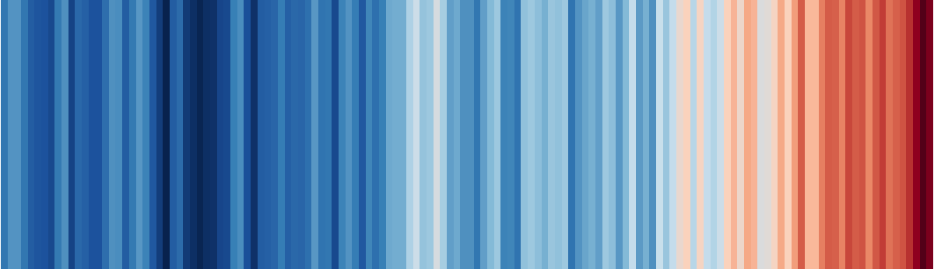
Visualizing information
EMSE 4197 | John Paul Helveston | January 29, 2020

Slide 2
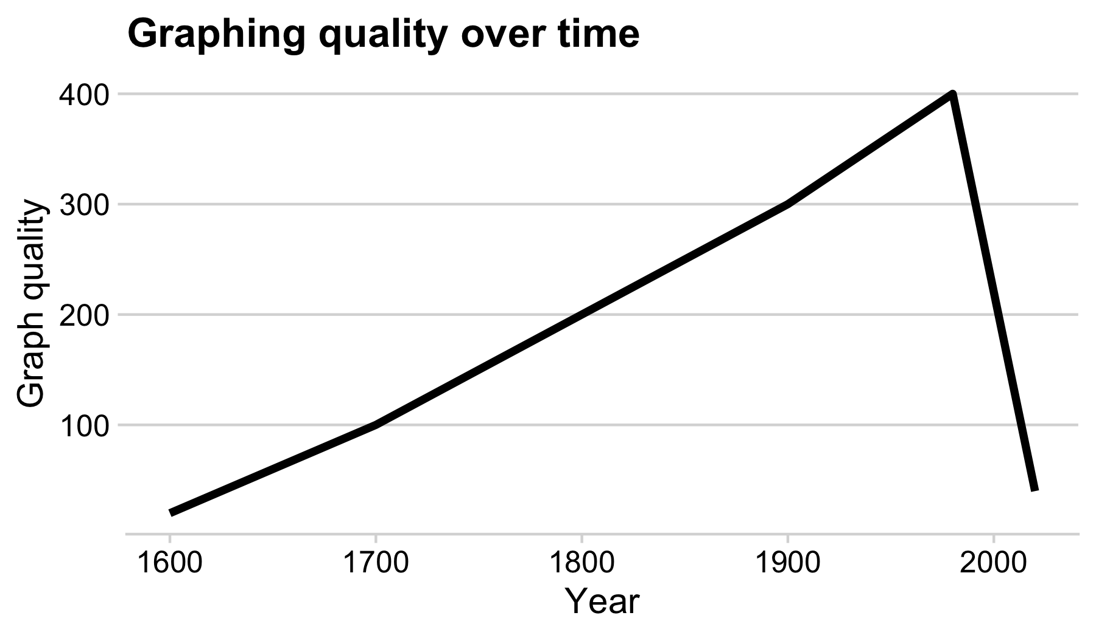

Slide 3
“Having word processing software doesn’t make us great writers.” - Stephen Few

Slide 4
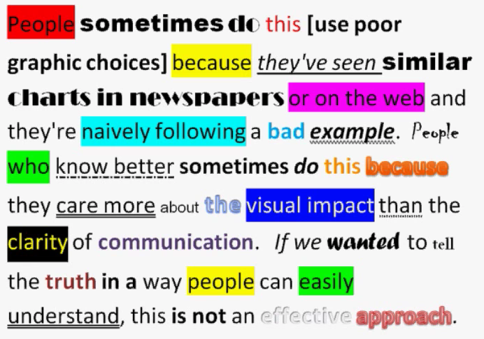
We don’t write paragraphs like this:
So don’t make graphs like this:
Image from Few (2012, pg. 227)
Image from excelcharts.com

Slide 5
Good visualizations optimize for the human visual-memory system
5

Slide 6
A (very) simplified model of visual-memory system
Iconic memory
< 1 sec.
“Pre-attentive”
Attention “grabbed”
Working memory
< few hours
Limited (3-4 chunks)
Information / main message
Effective charts focus on this
Long-term memory
Lifetime

Slide 7
Two objectives of effective charts:
Grab & direct attention (iconic memory)
Reduce processing demands (working memory)

Slide 8
The power of pre-attentive processing
Count all the “5”s:
821134907856412043612
304589640981709812734
123450986124790812734
029860192837401489363
123479827961203459816
234009816256908127634
123459087162342015237
123894789237498230192

Slide 9
The power of pre-attentive processing
Count all the “5”s:
821134907856412043612
304589640981709812734
123450986124790812734
029860192837401489363
123479827961203459816
234009816256908127634
123459087162342015237
123894789237498230192

Slide 10
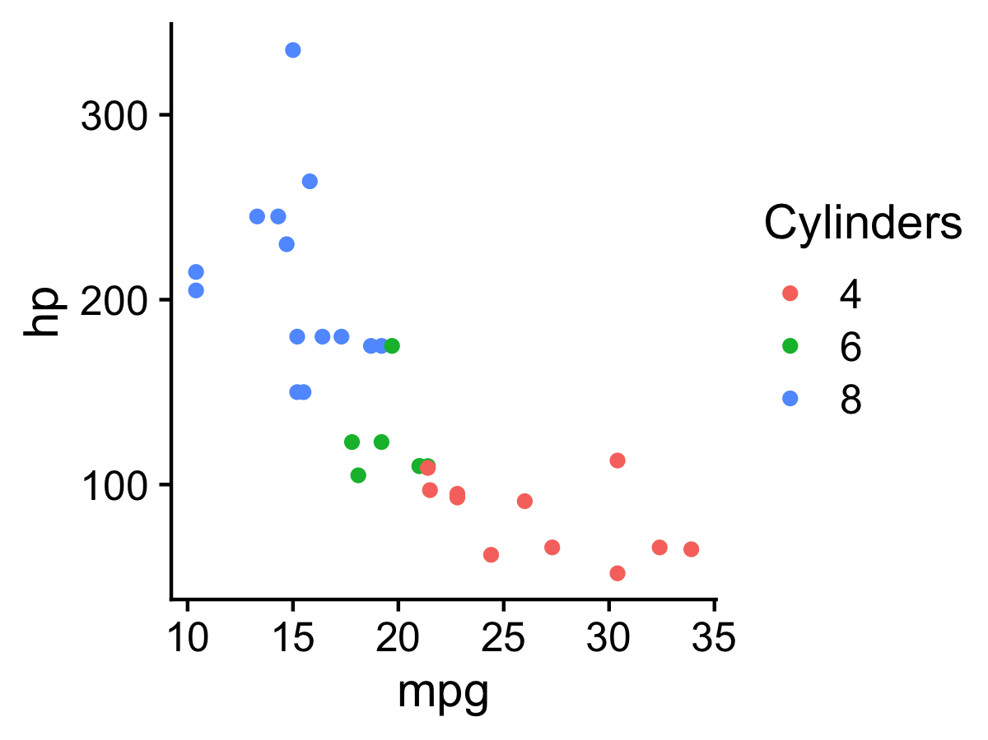
Pre-attentive attributes
Numerical (ratio) data
Categorical (ordinal) data

Slide 11
Not all pre-attentive attributes are equal
11

Slide 12
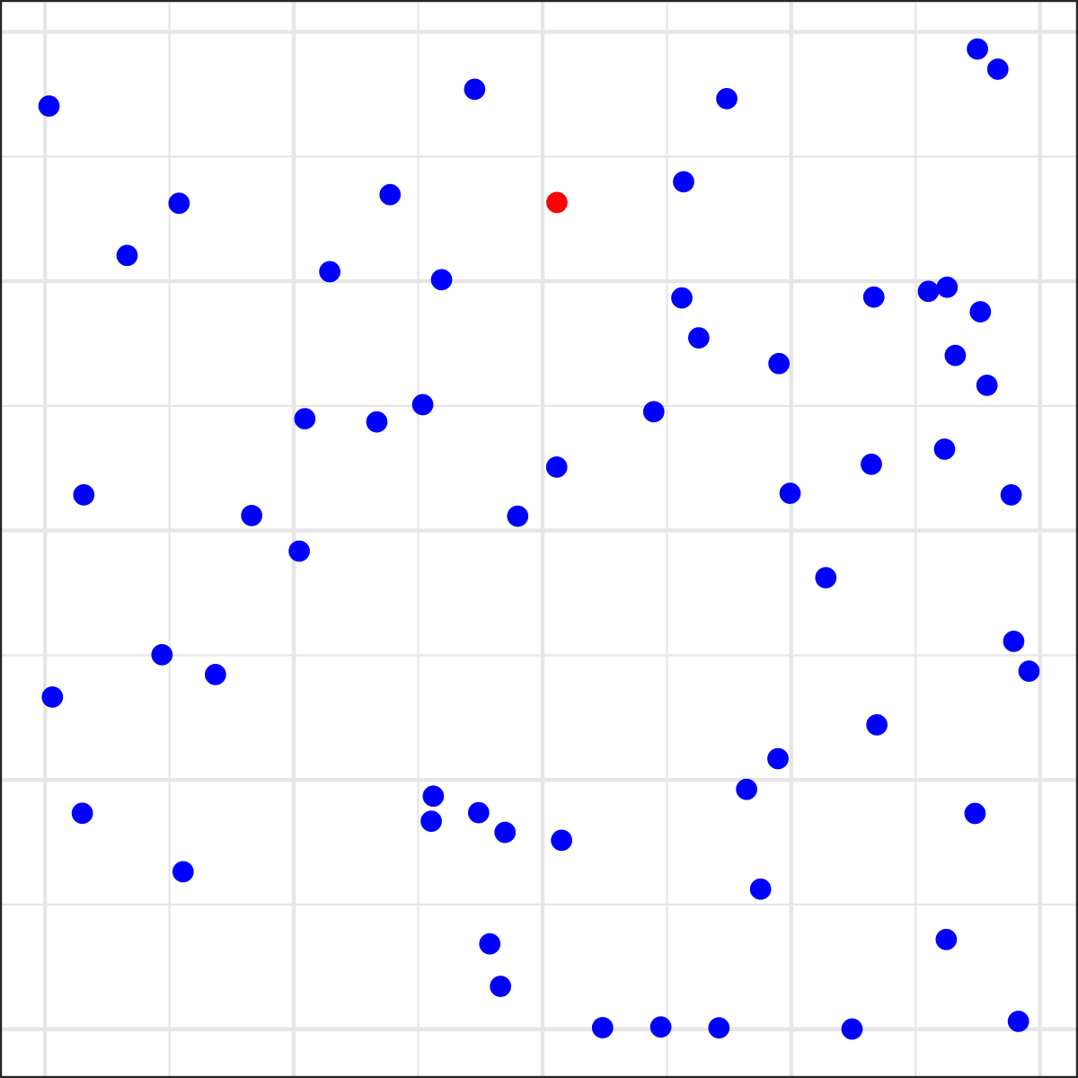
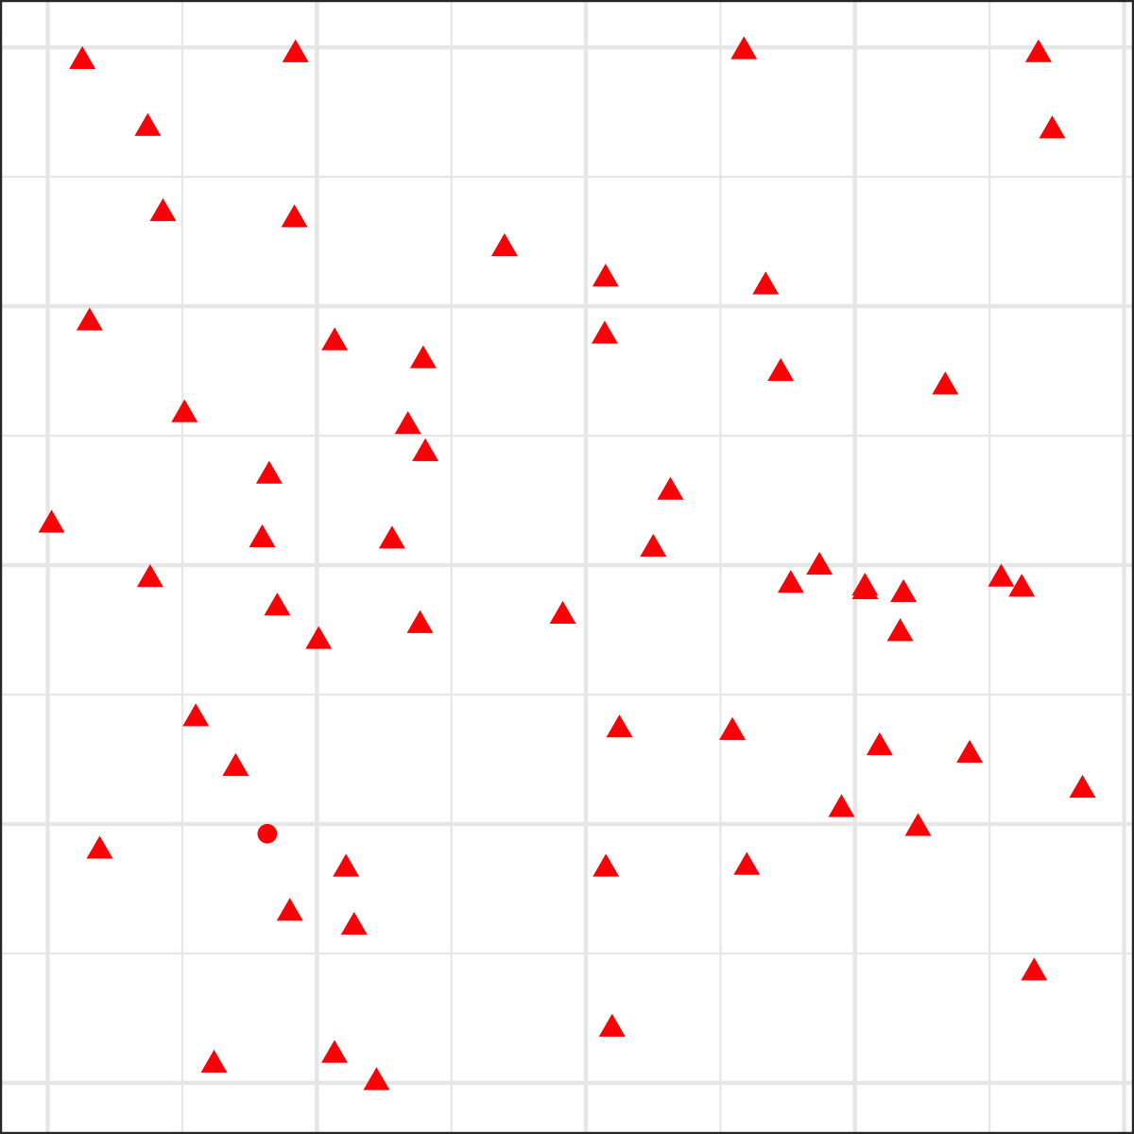
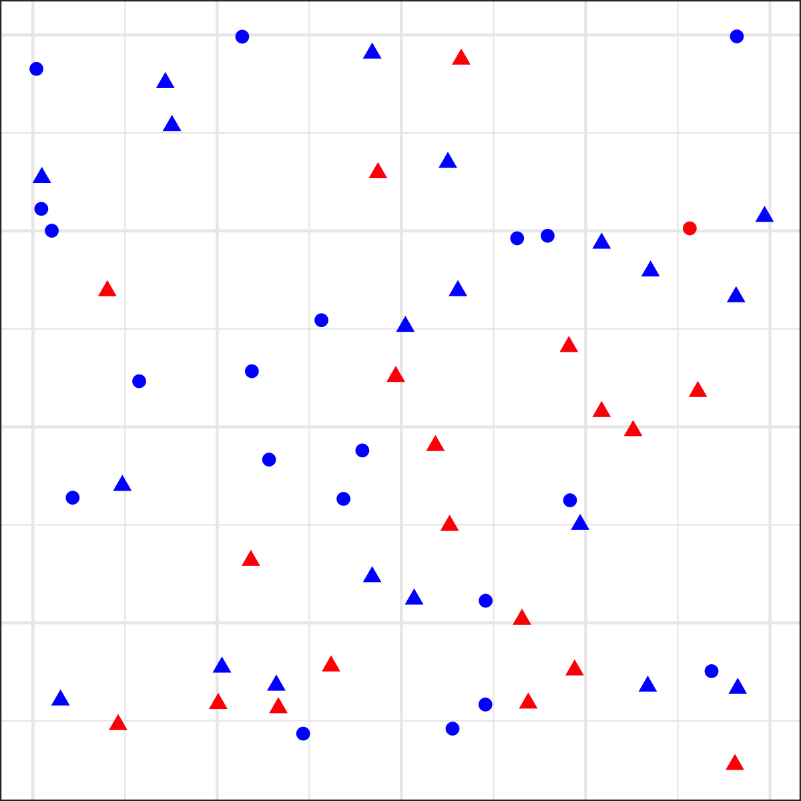
Is there a red dot?

Slide 13
For categorical data
Hue > Shape
Less is more

Slide 14
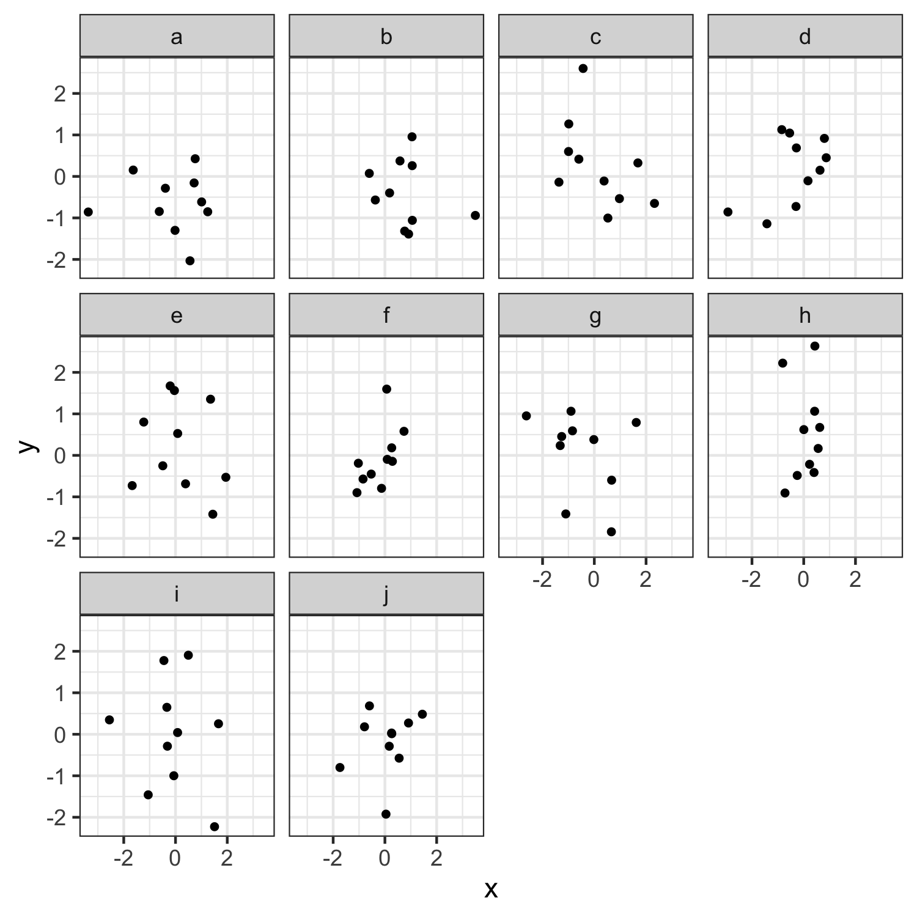
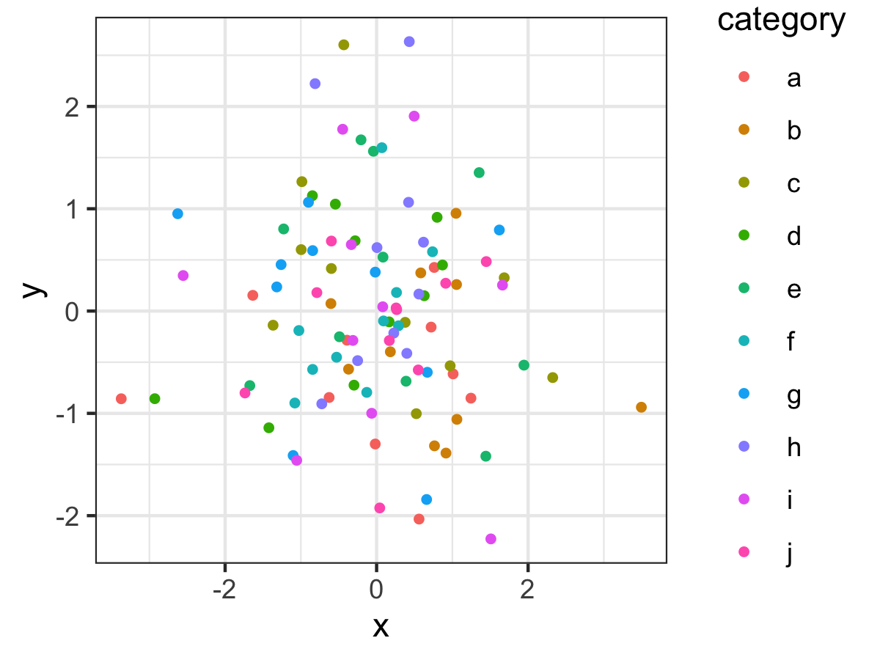

Slide 15
Graph components
15

Slide 16
Graph components
Geoms:
points, lines, boxes, bars, etc.

Slide 17
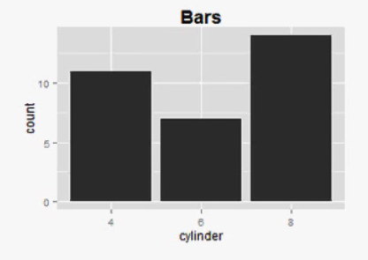
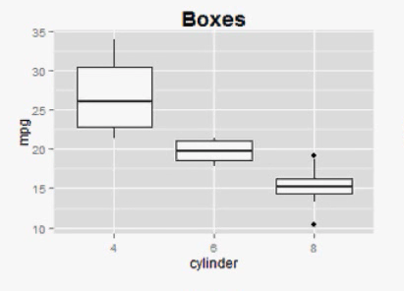
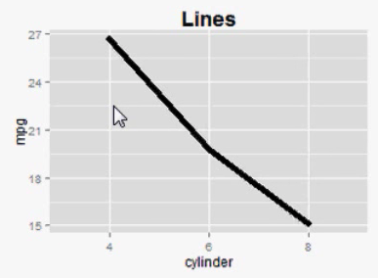
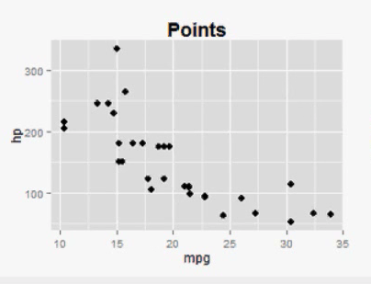
Geoms: geometric shapes used to represent data

Slide 18
Graph components
Geoms:
points, lines, boxes, bars, etc.
Pre-attentive attributes:
position, color, shape, curvature, etc.
Non-data ink:
scales, grid lines, legend, labels, etc.
No “chart junk” (Tufte, 2001)

Slide 19
“Erase non-data ink.” - Edward Tufte

Slide 20
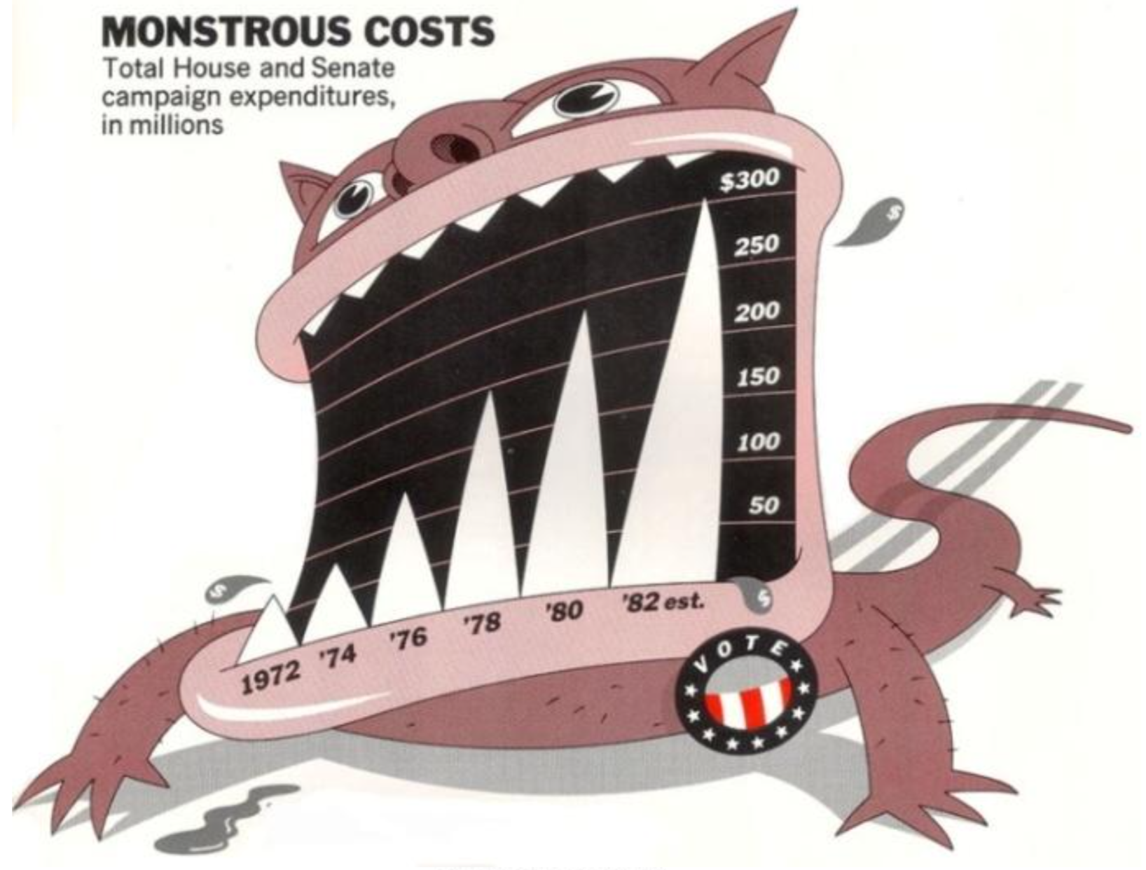
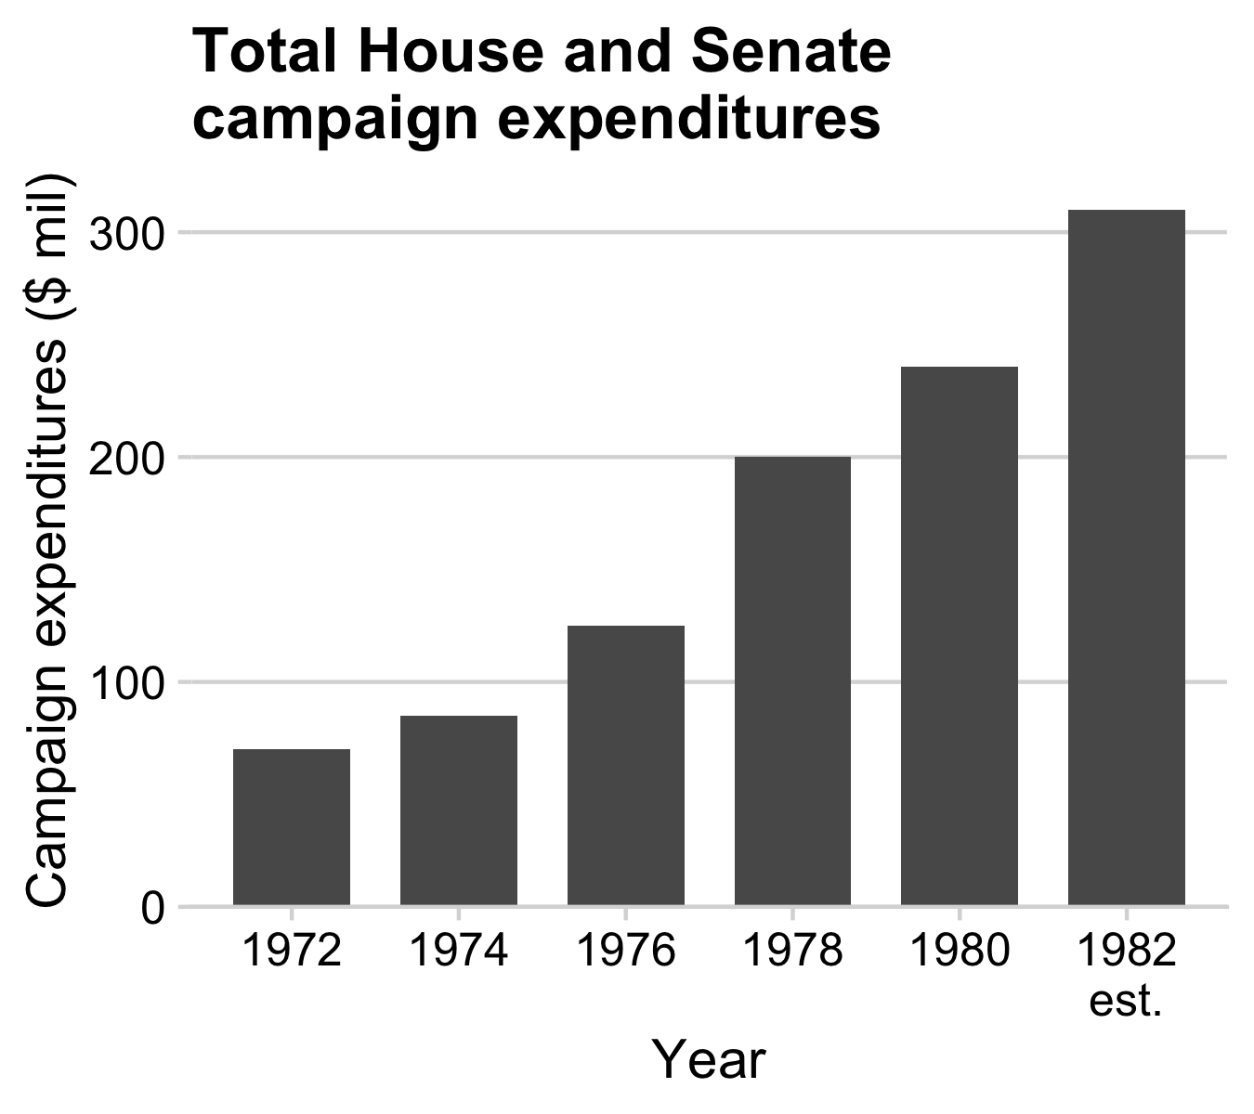
Figure 1.6: `Monstrous Costs’ by Nigel Holmes, in Healy, 2018

Slide 21
Lessons from Psychology research
21

Slide 22
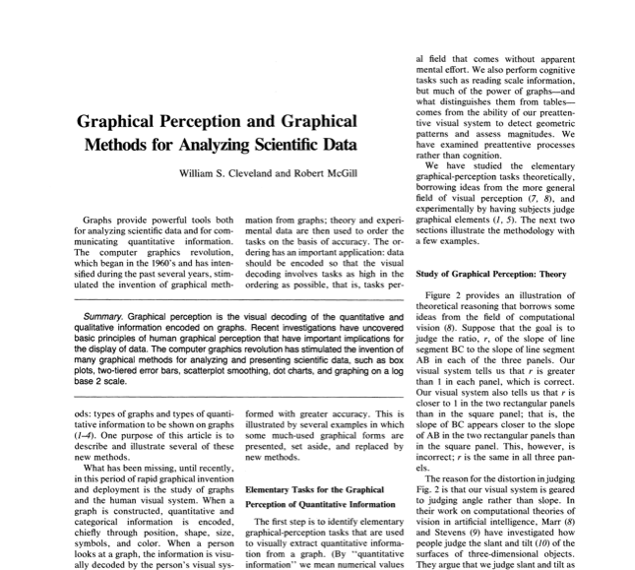
Cleveland, W. S., & McGill, R. (1985). Graphical perception and graphical methods for analyzing scientific data. Science, New Series, 229(4716), 828-833.

Slide 23
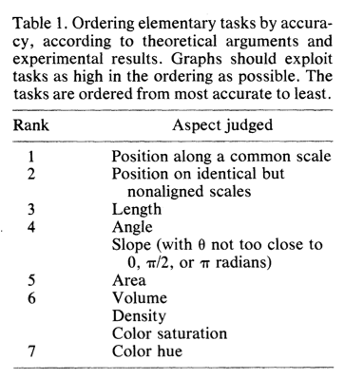
Cleveland, W. S., & McGill, R. (1985). Graphical perception and graphical methods for analyzing scientific data. Science, New Series, 229(4716), 828-833.

Slide 24
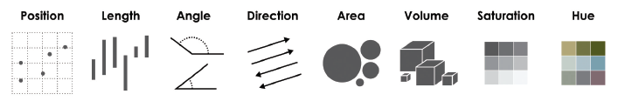
Pattern recognition hierarchy for numerical data:
← More accurate
Less accurate →

Slide 25
Full disclosure:
Much of the next 50-ish slides are from John Rauser’s talk on YouTube
25

Slide 26
Cleveland’s three visual operations of pattern perception:
Estimation
Assembly
Detection
Discrimination X != Y
Ranking X > Y
Ratioing X / Y
26

Slide 27
“At the heart of quantitative reasoning is a single question: compared to what?” - Edward Tufte

Slide 28
Position on a common scale
Position on non-aligned scales
Length
Angle
Area
Color saturation
Color hue

Slide 29
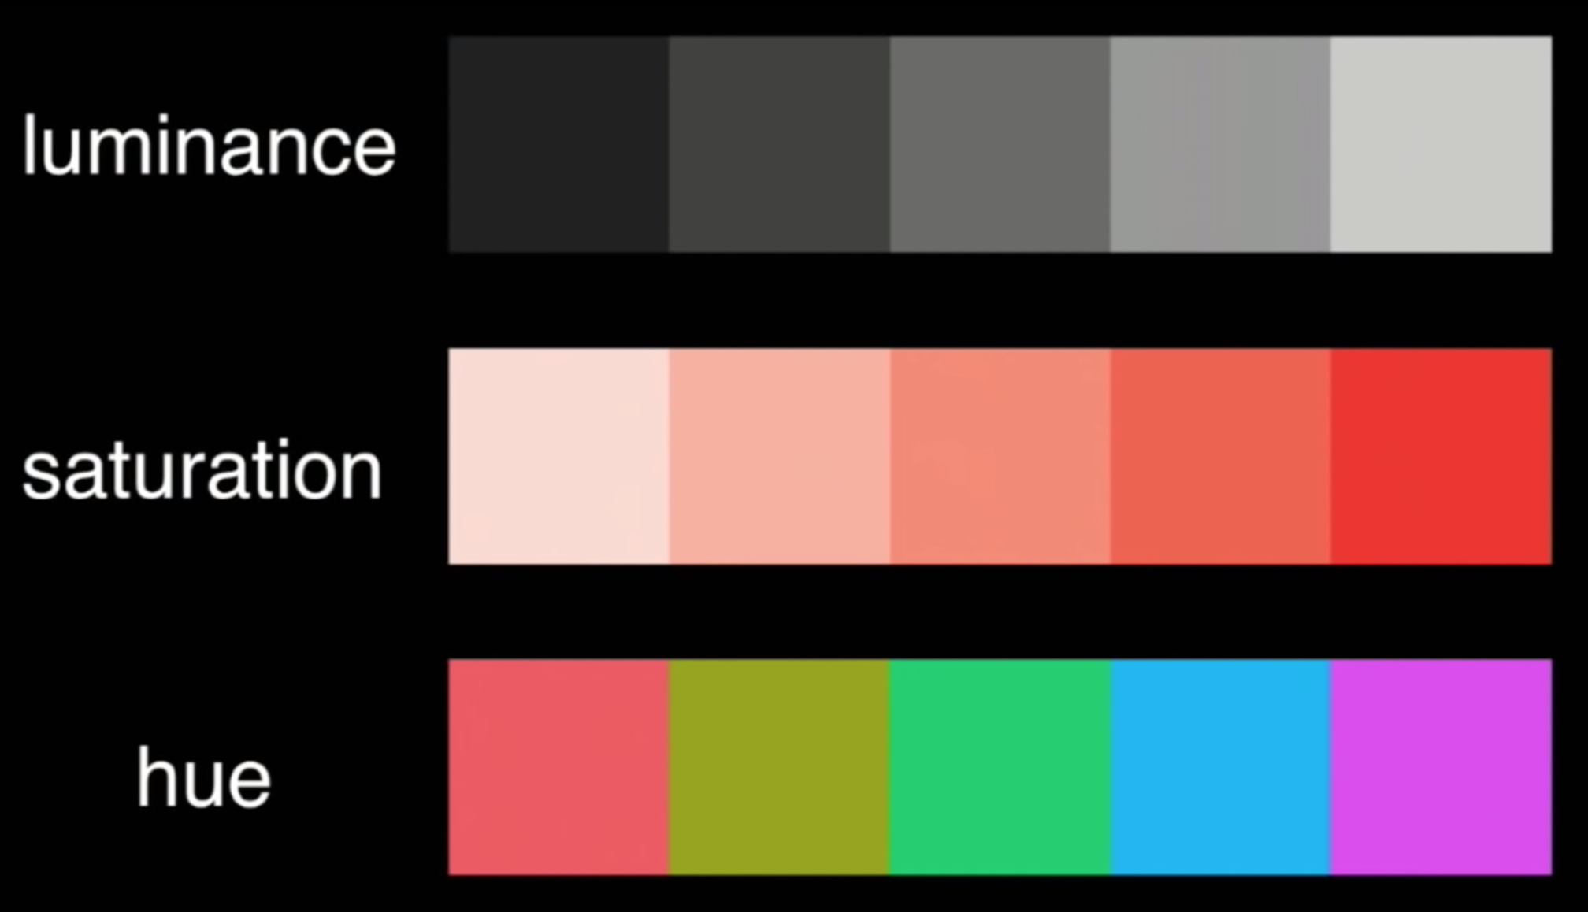

Slide 30
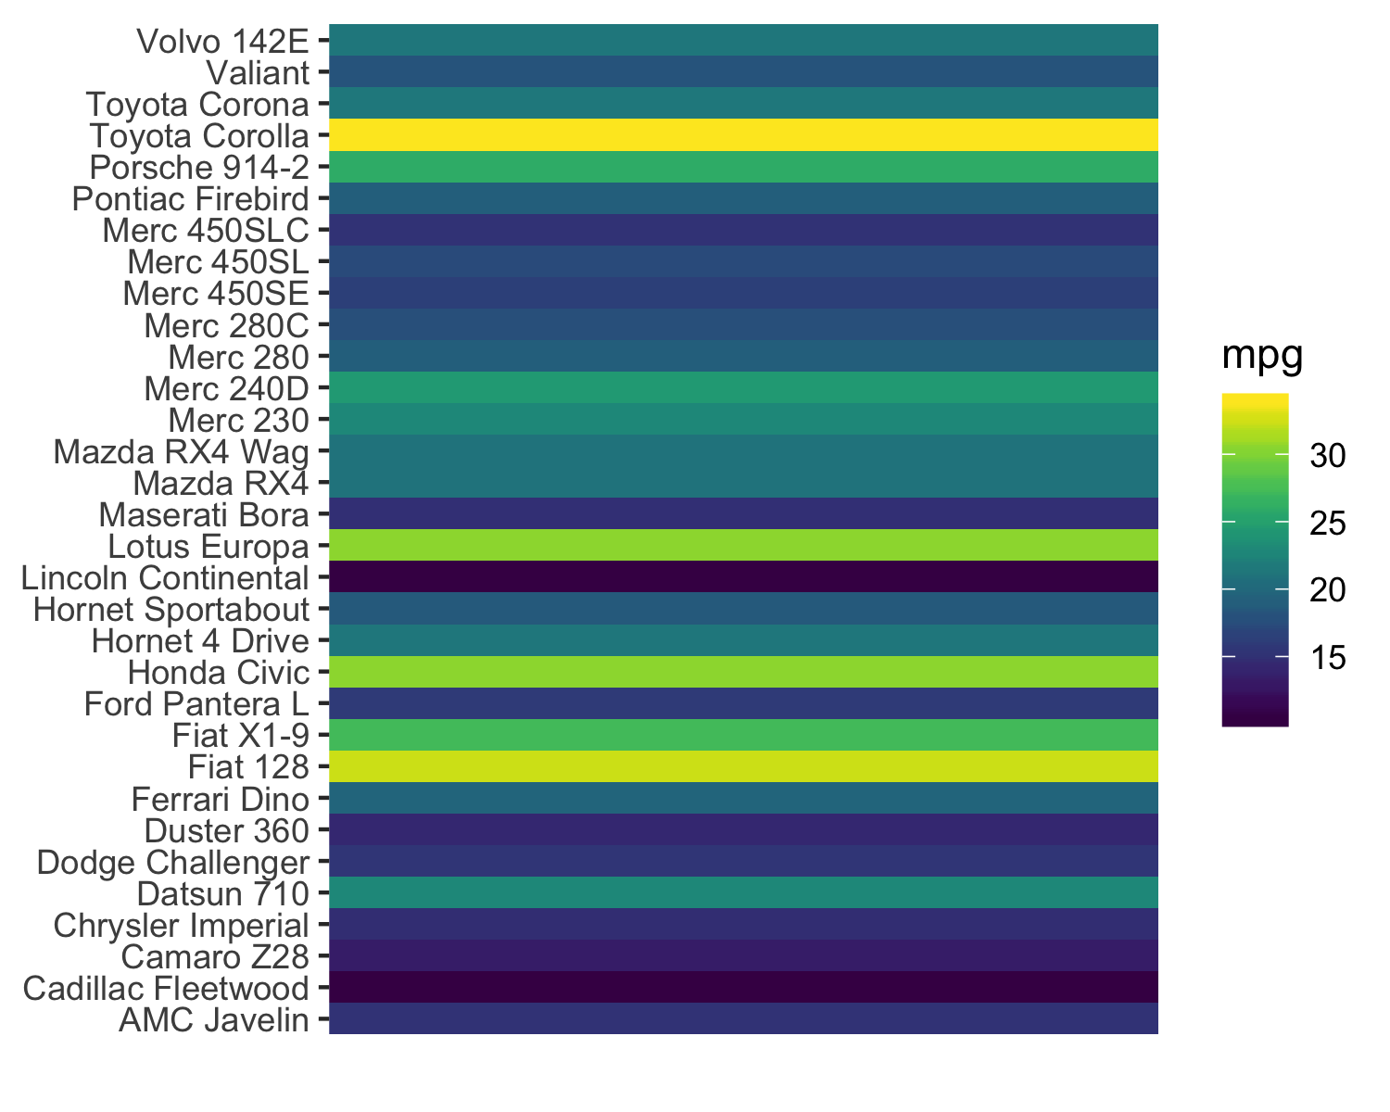
Position on a common scale
Position on non-aligned scales
Length
Angle
Area
Color saturation
Color hue
Discrimination?

Slide 31
Position on a common scale
Position on non-aligned scales
Length
Angle
Area
Color saturation
Color hue
Discrimination?

Slide 32
Position on a common scale
Position on non-aligned scales
Length
Angle
Area
Color saturation
Color hue
Ranking?

Slide 33
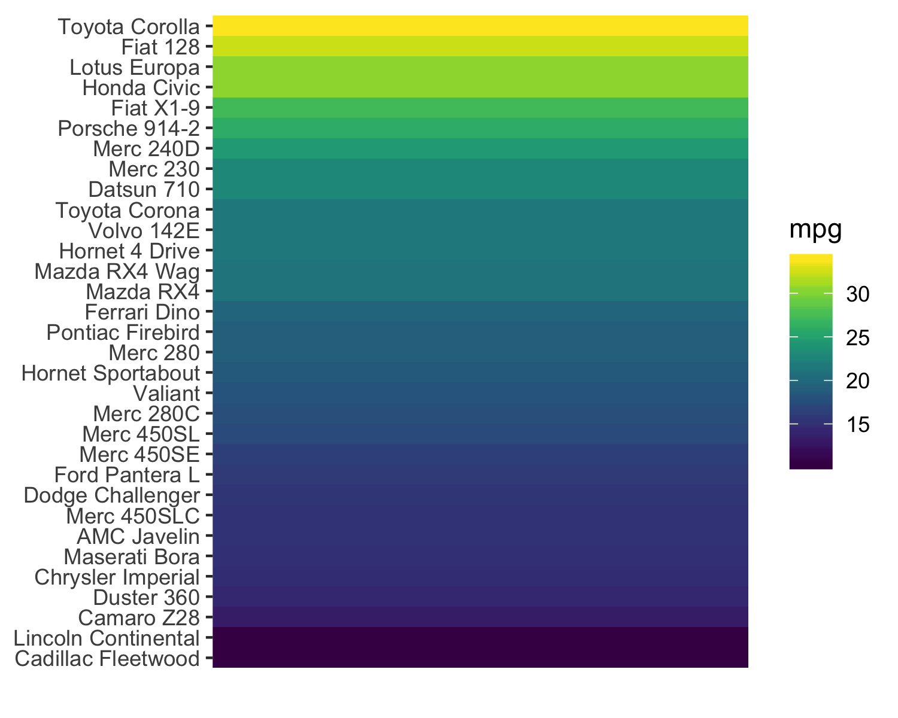
Position on a common scale
Position on non-aligned scales
Length
Angle
Area
Color saturation
Color hue
Ranking?

Slide 34
Position on a common scale
Position on non-aligned scales
Length
Angle
Area
Color saturation
Color hue
Discrimination?

Slide 35
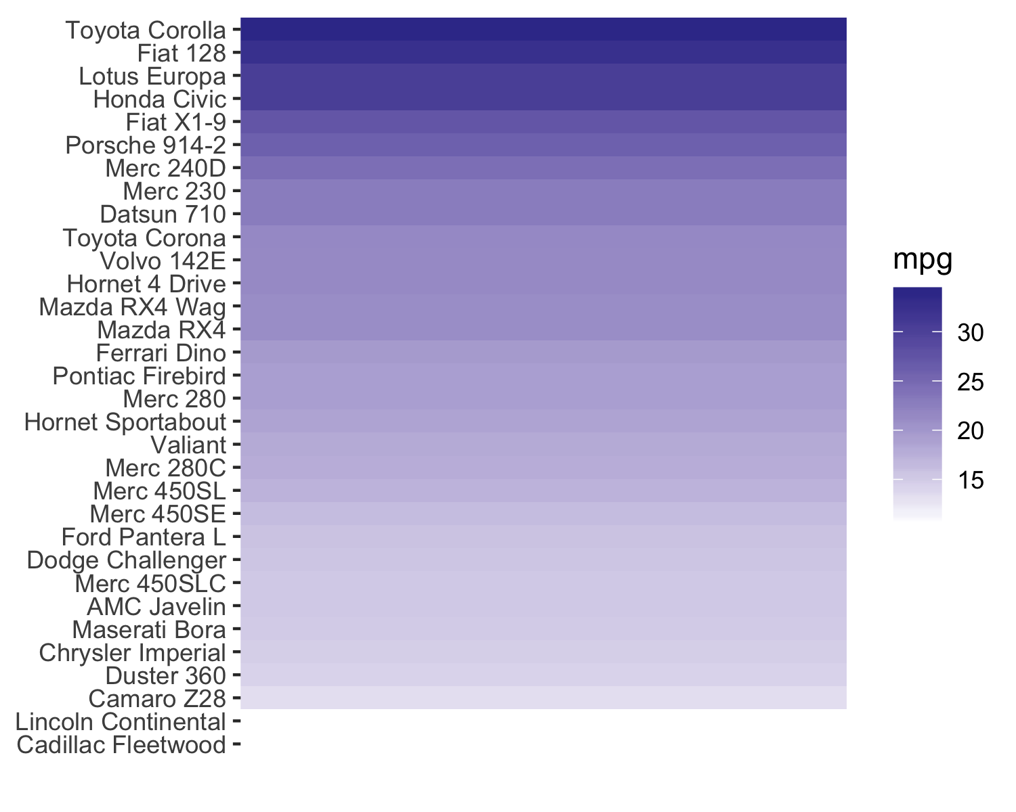
Position on a common scale
Position on non-aligned scales
Length
Angle
Area
Color saturation
Color hue

Slide 36
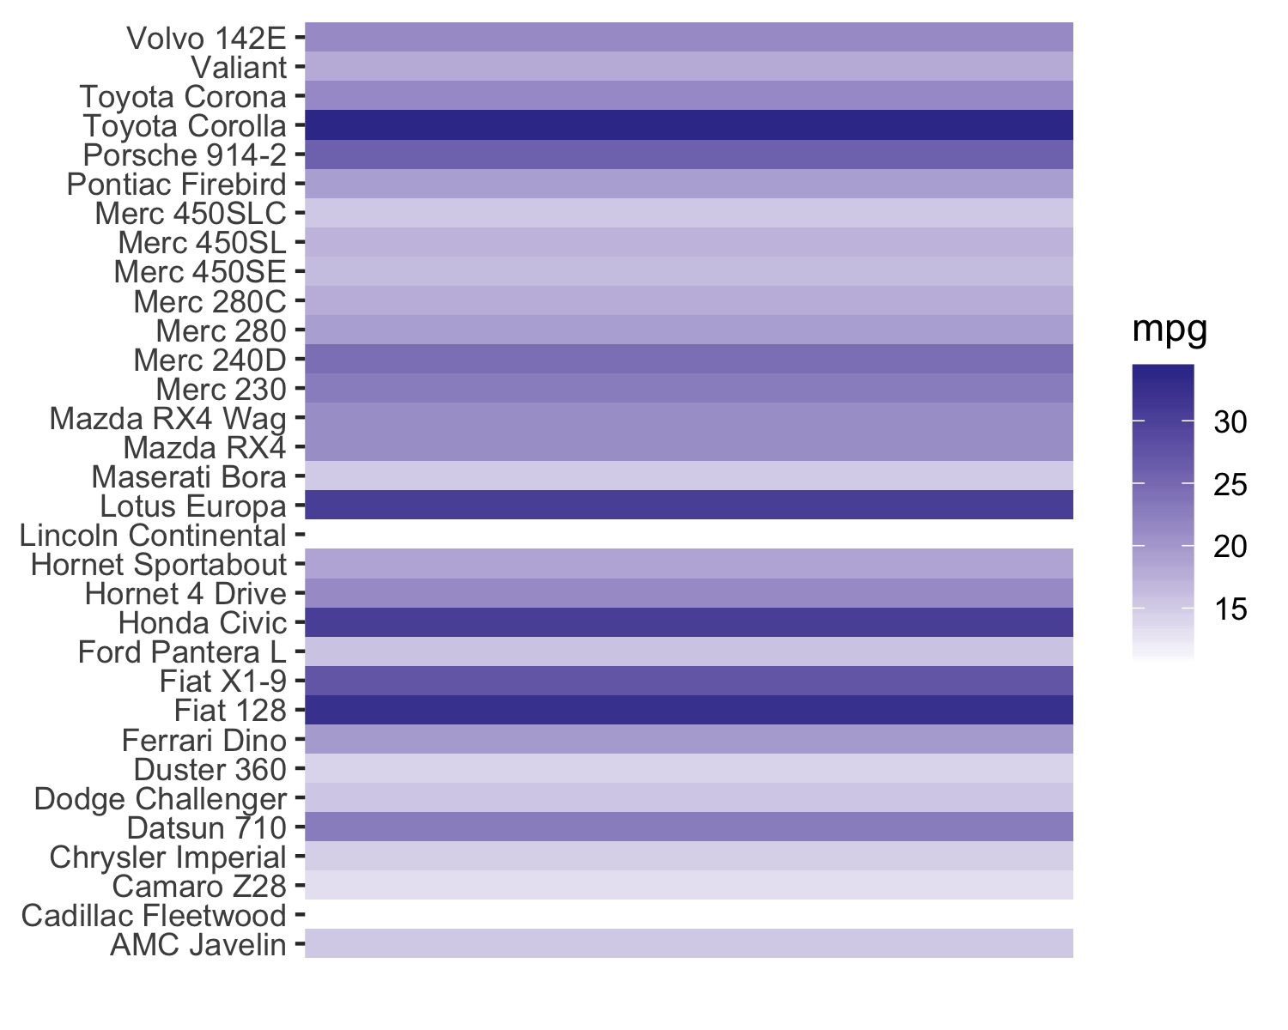
Position on a common scale
Position on non-aligned scales
Length
Angle
Area
Color saturation
Color hue

Slide 37
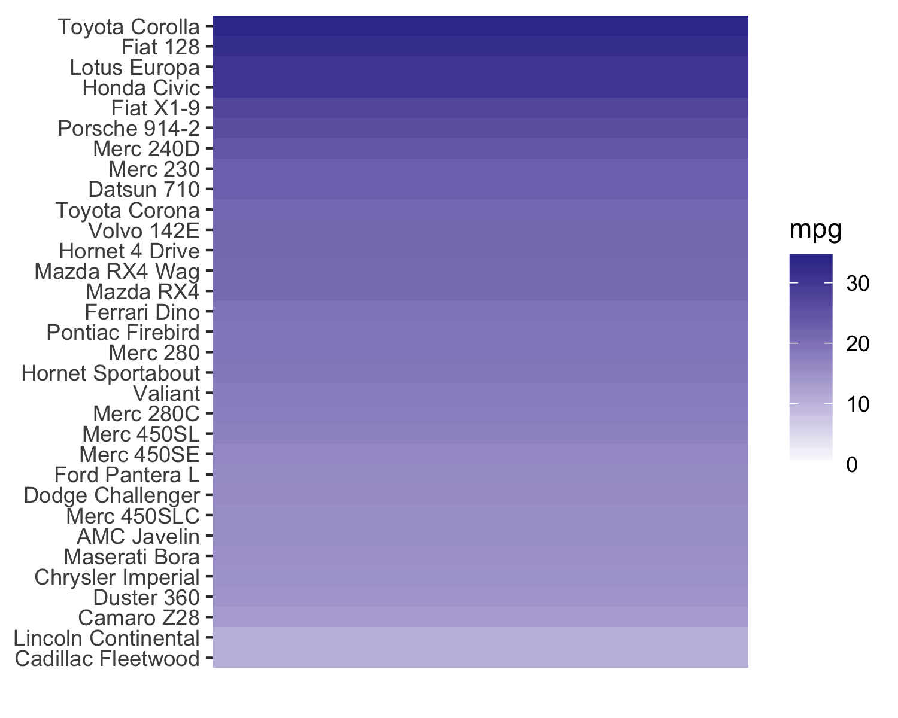
Position on a common scale
Position on non-aligned scales
Length
Angle
Area
Color saturation
Color hue
Ratioing?

Slide 38
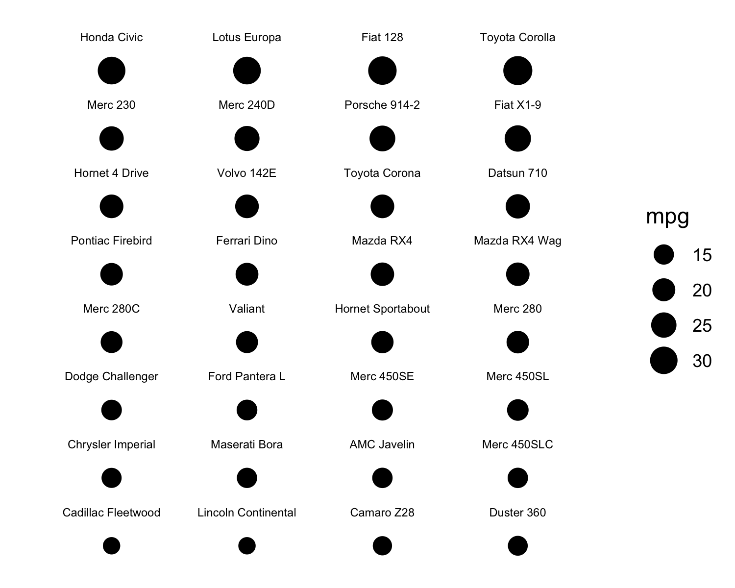
Position on a common scale
Position on non-aligned scales
Length
Angle
Area
Color saturation
Color hue
Ratioing?

Slide 39
Position on a common scale
Position on non-aligned scales
Length
Angle
Area
Color saturation
Color hue
Discrimination?
Ranking?

Slide 40
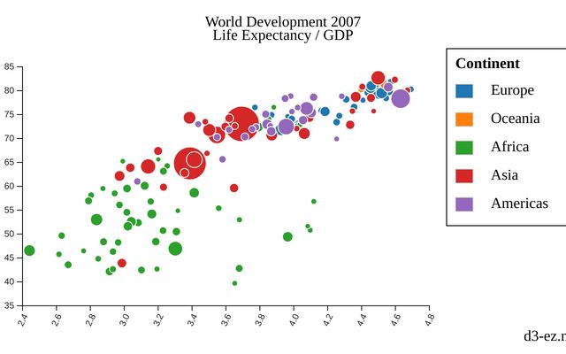
Position on a common scale
Position on non-aligned scales
Length
Angle
Area
Color saturation
Color hue

Slide 41
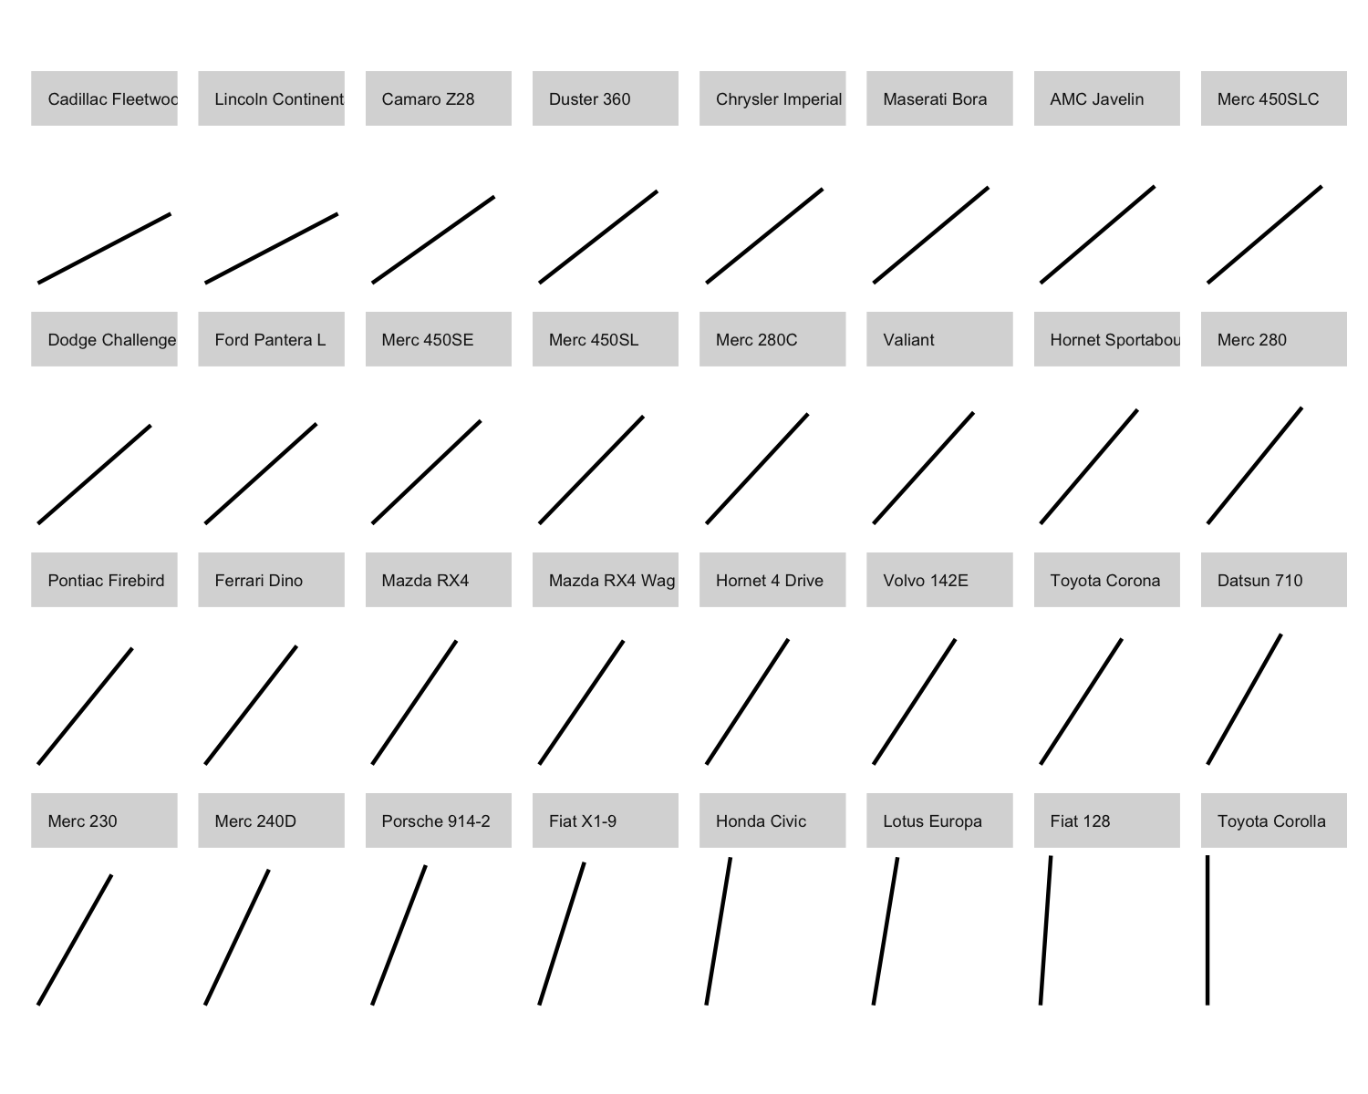
Position on a common scale
Position on non-aligned scales
Length
Angle
Area
Color saturation
Color hue
Ratioing?

Slide 42
Position on a common scale
Position on non-aligned scales
Length
Angle
Area
Color saturation
Color hue
Discrimination?
Ranking?

Slide 43
Position on a common scale
Position on non-aligned scales
Length
Angle
Area
Color saturation
Color hue

Slide 44
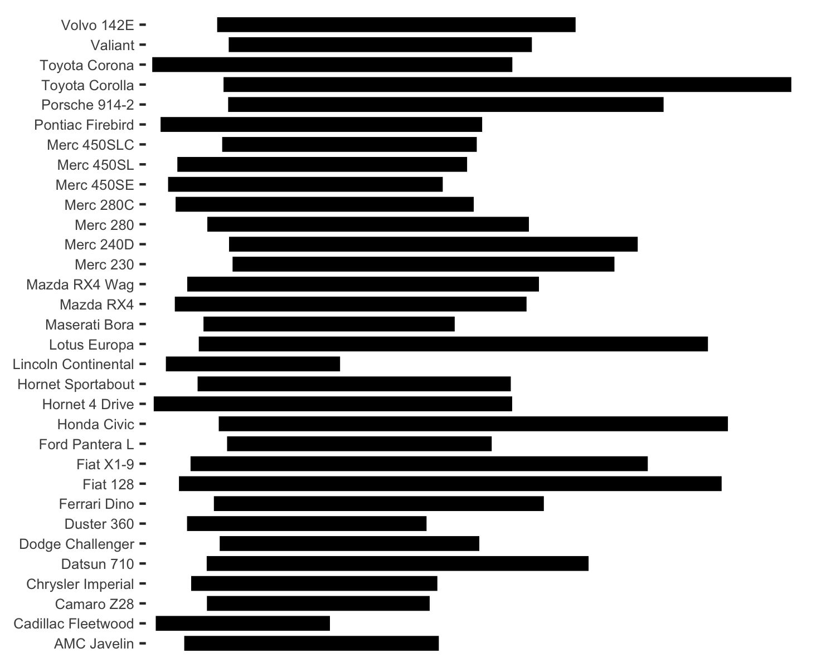
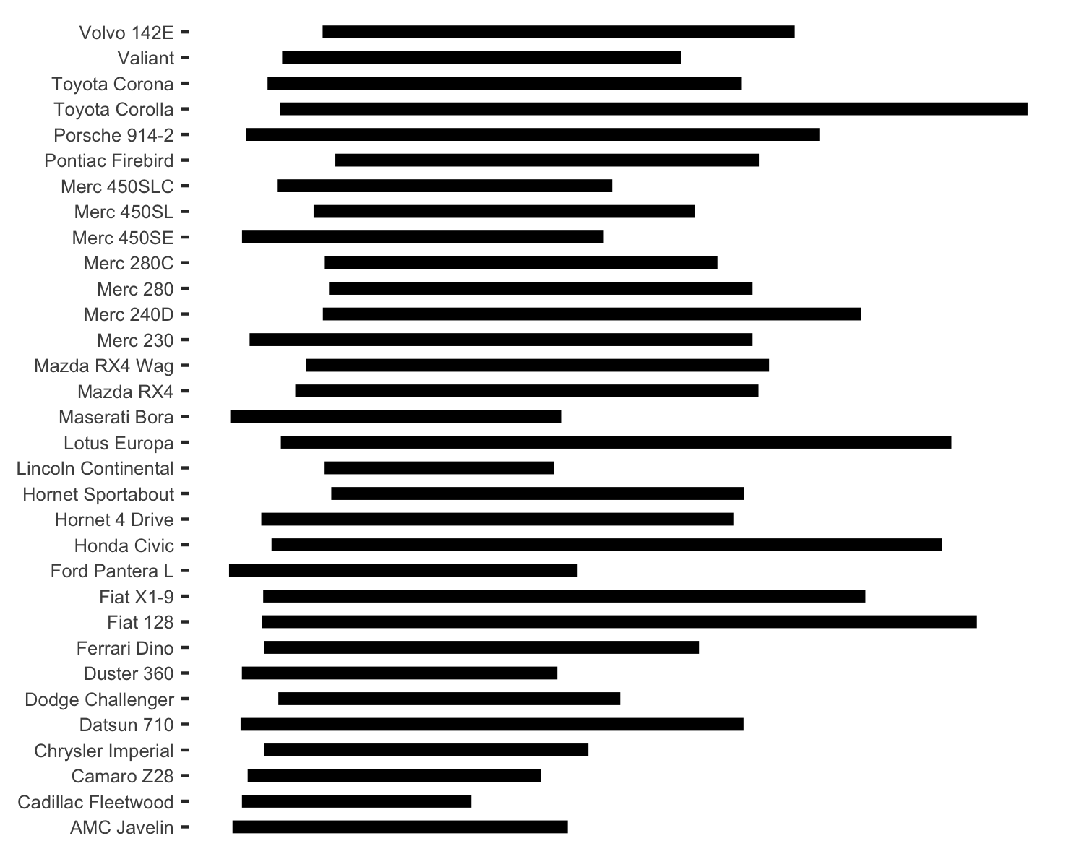
Position on a common scale
Position on non-aligned scales
Length
Angle
Area
Color saturation
Color hue
Ratioing?
15 mpg

Slide 45
Position on a common scale
Position on non-aligned scales
Length
Angle
Area
Color saturation
Color hue
Discrimination?
Ranking?
15 mpg

Slide 46
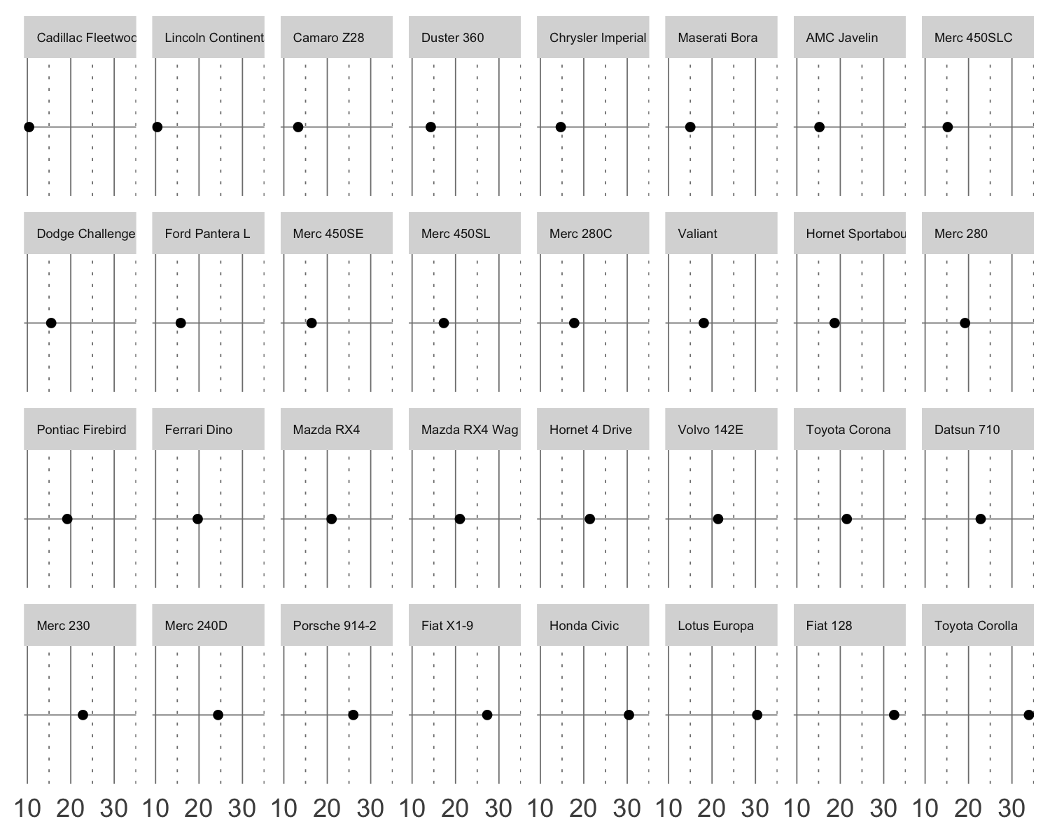
Position on a common scale
Position on non-aligned scales
Length
Angle
Area
Color saturation
Color hue
Discrimination?
Ranking?

Slide 47
Position on a common scale
Position on non-aligned scales
Length
Angle
Area
Color saturation
Color hue
Ratioing?

Slide 48
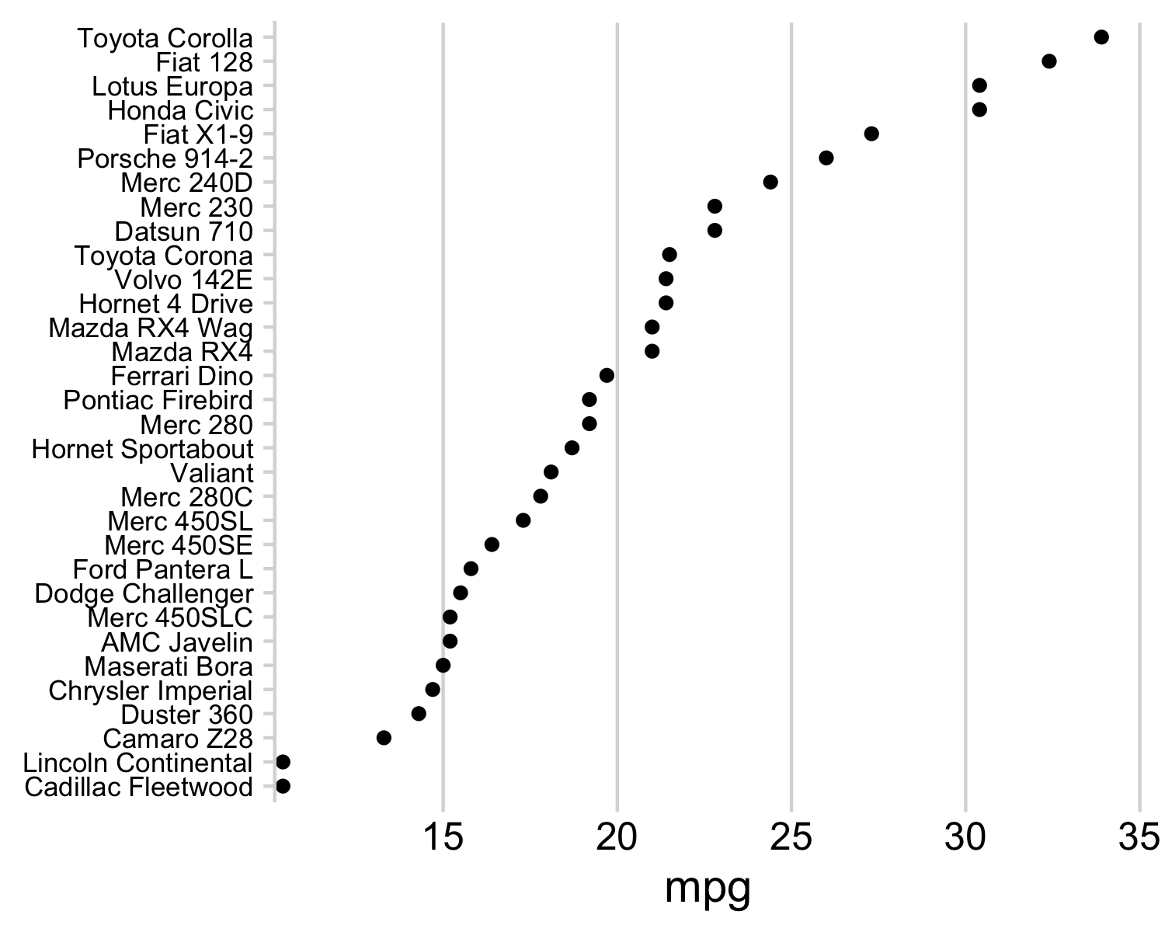
Position on a common scale
Position on non-aligned scales
Length
Angle
Area
Color saturation
Color hue
Ratioing?

Slide 49
Position on a common scale
Position on non-aligned scales
Length
Angle
Area
Color saturation
Color hue
Discrimination?
Ranking?

Slide 50
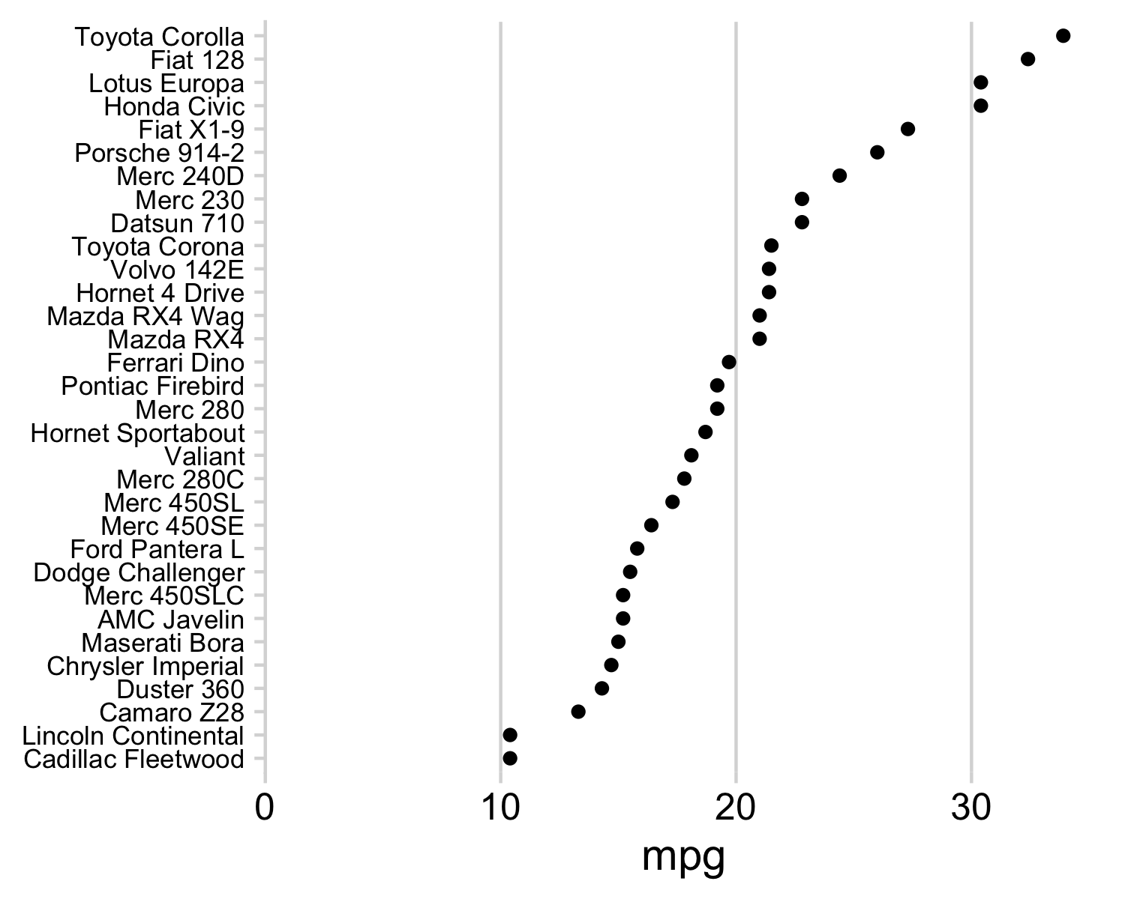
Position on a common scale
Position on non-aligned scales
Length
Angle
Area
Color saturation
Color hue
No need to scale to 0:
Lowers resolution
Isn't needed for accurate ratioing

Slide 51
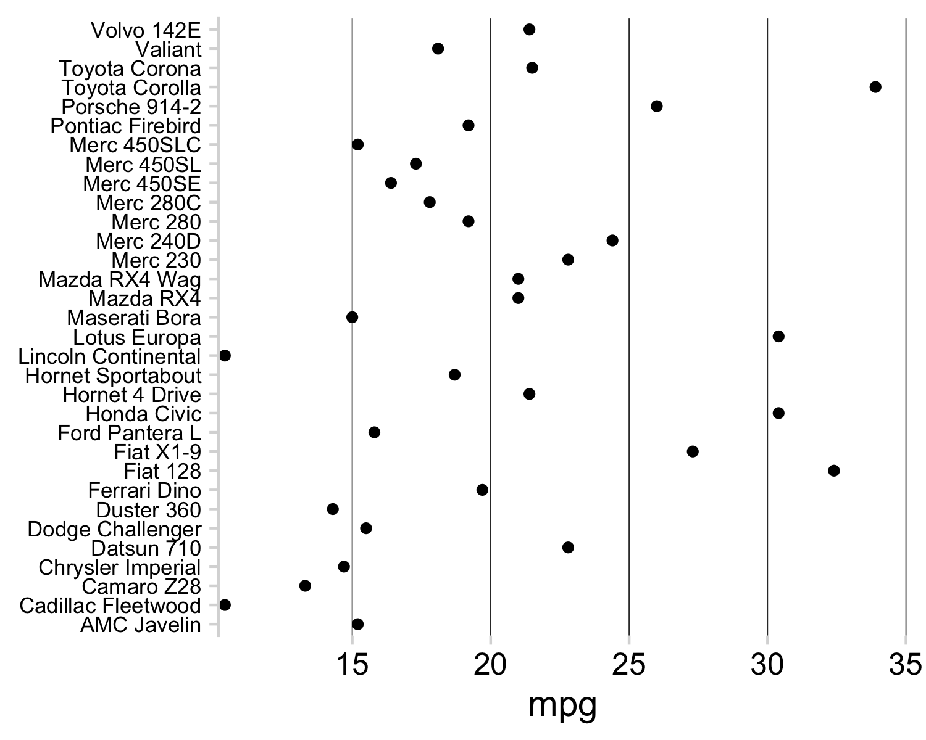
Position on a common scale
Position on non-aligned scales
Length
Angle
Area
Color saturation
Color hue
Ordering still crucial

Slide 52
Cleveland’s three visual operations of pattern perception:
Estimation
Assembly
Detection
The grouping of graphical elements
52

Slide 53
Gestalt Psychology
The whole has a reality that is entirely separate from the parts
53

Slide 54

Notes:
You experience more special information than is explicitly present in an image

Slide 55

Reification
Notes:
You experience more information than is explicitly present in an image

Slide 56
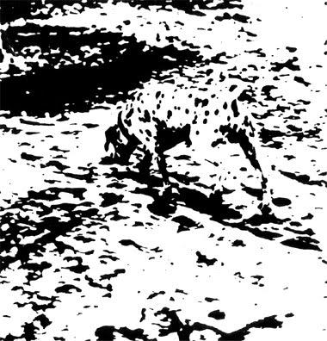
Emergence

Slide 57
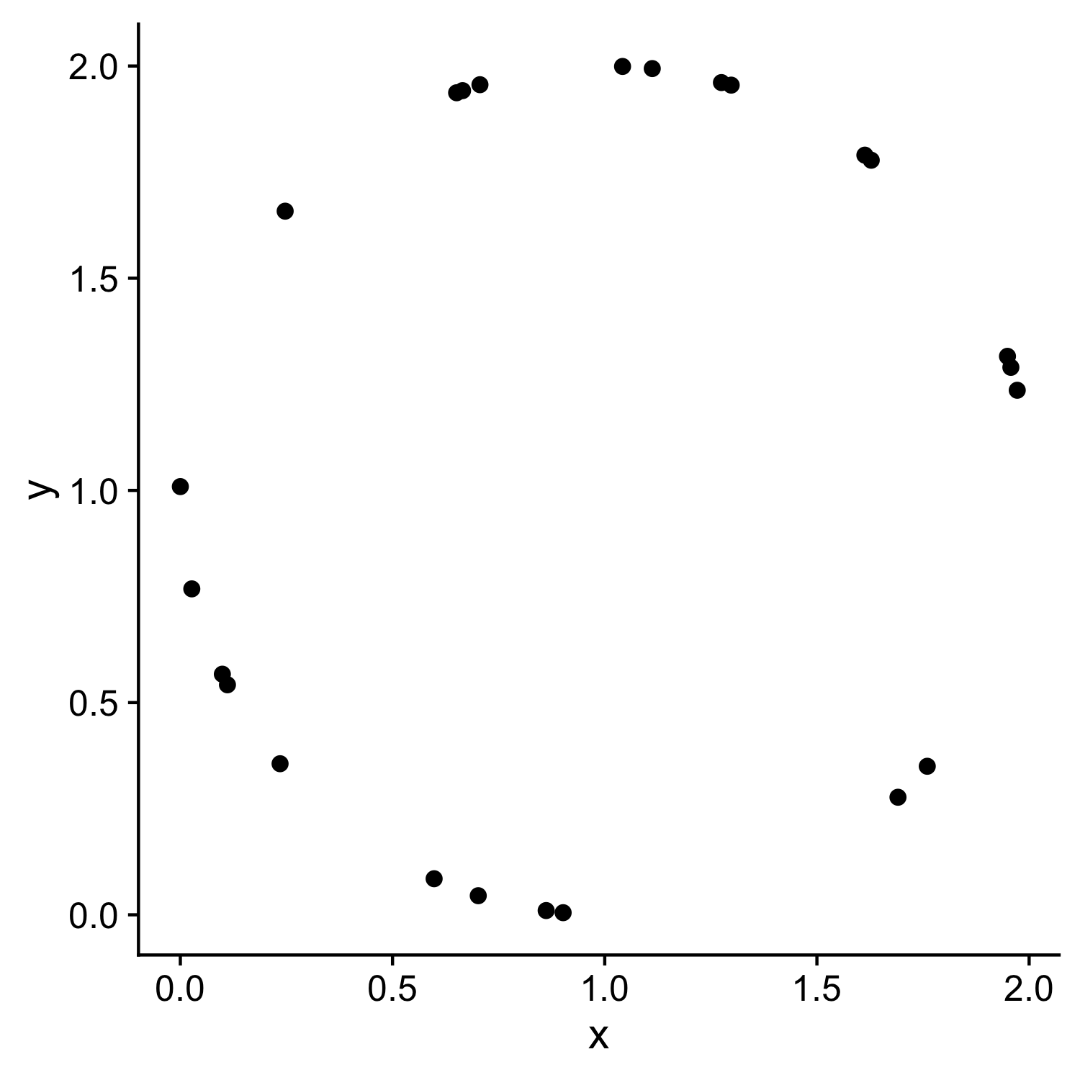
X | y
1.972 | 1.236
1.112 | 1.994
0 | 1.009
0.665 | 1.942
0.235 | 0.356
0.247 | 1.658
1.275 | 1.961
0.702 | 0.045
1.76 | 0.35
1.691 | 0.277
1.628 | 1.778
1.957 | 1.29
0.111 | 0.542
0.902 | 0.005
0.598 | 0.085
1.613 | 1.79
1.298 | 1.955
0.651 | 1.937
1.949 | 1.316
0.099 | 0.567
0.862 | 0.01
0.027 | 0.768
0.706 | 1.956
1.042 | 1.999
Law of closure

Slide 58
Prägnanz
We strongly prefer to interpret stimuli as regular, simple, and orderly
58

Slide 60
Law of continuity
We will group together objects that follow an established direction

Slide 61
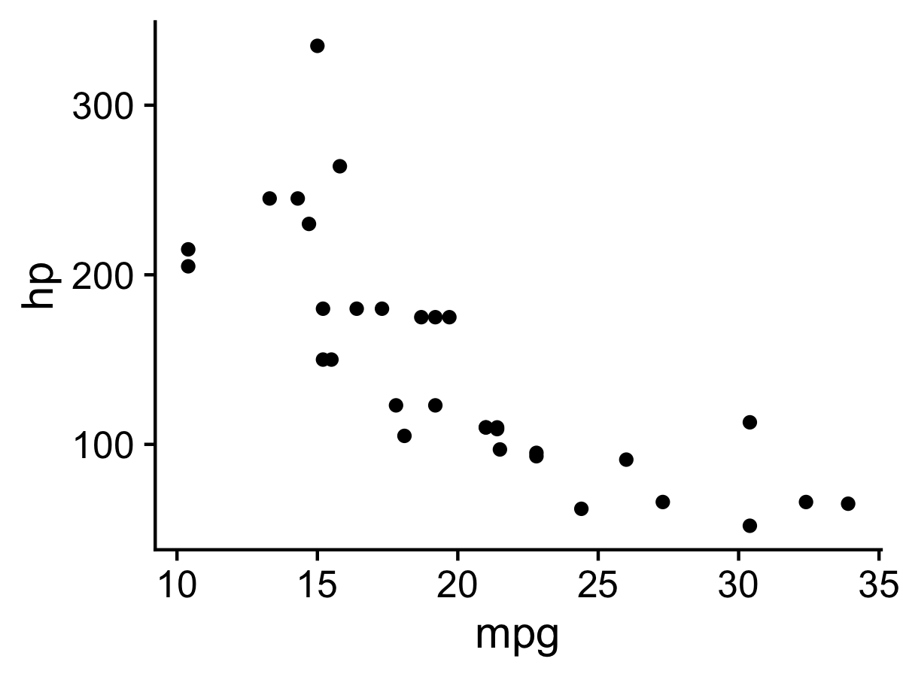
Law of continuity
We will group together objects that follow an established direction

Slide 62
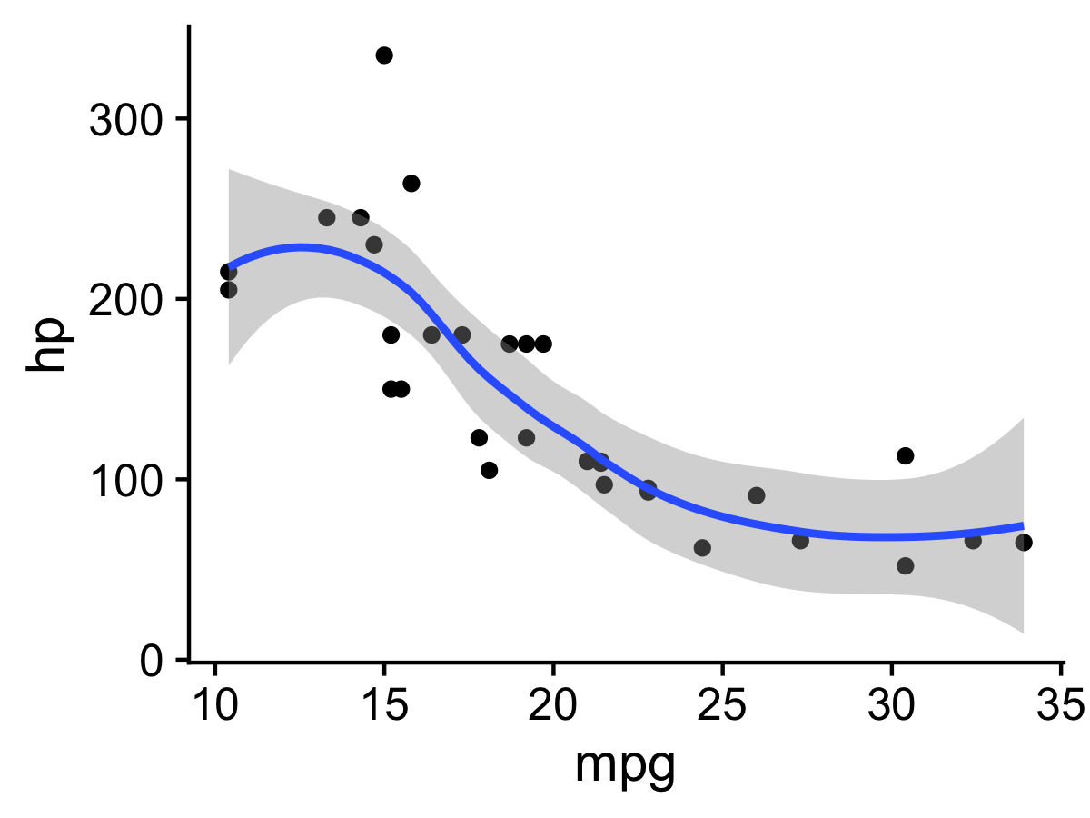
Law of continuity
We will group together objects that follow an established direction

Slide 63

Law of similarity
We tend to see elements that are physically similar as part of the same object

Slide 64
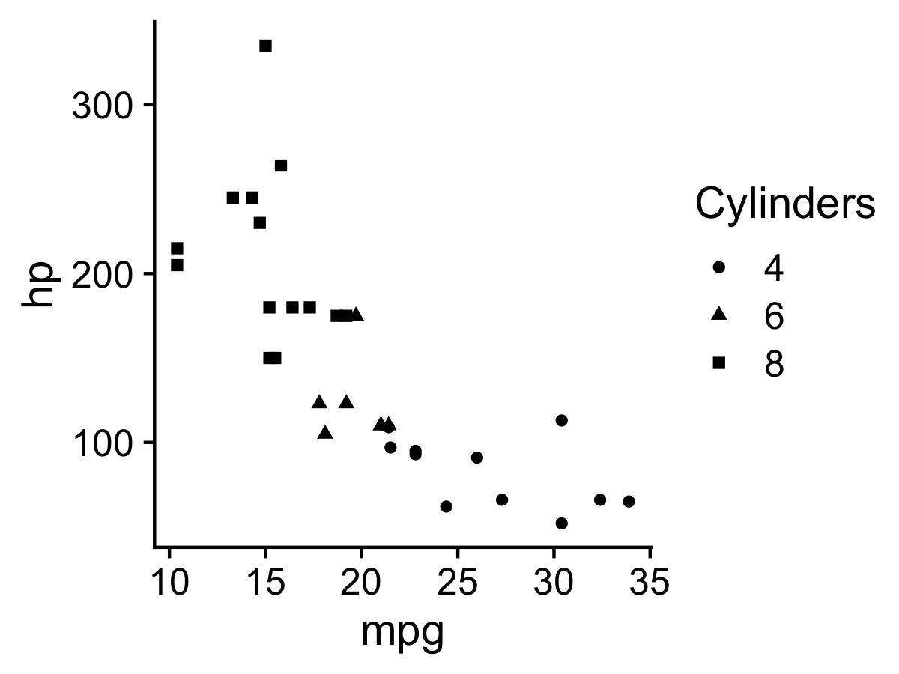
Law of similarity
We tend to see elements that are physically similar as part of the same object

Slide 65
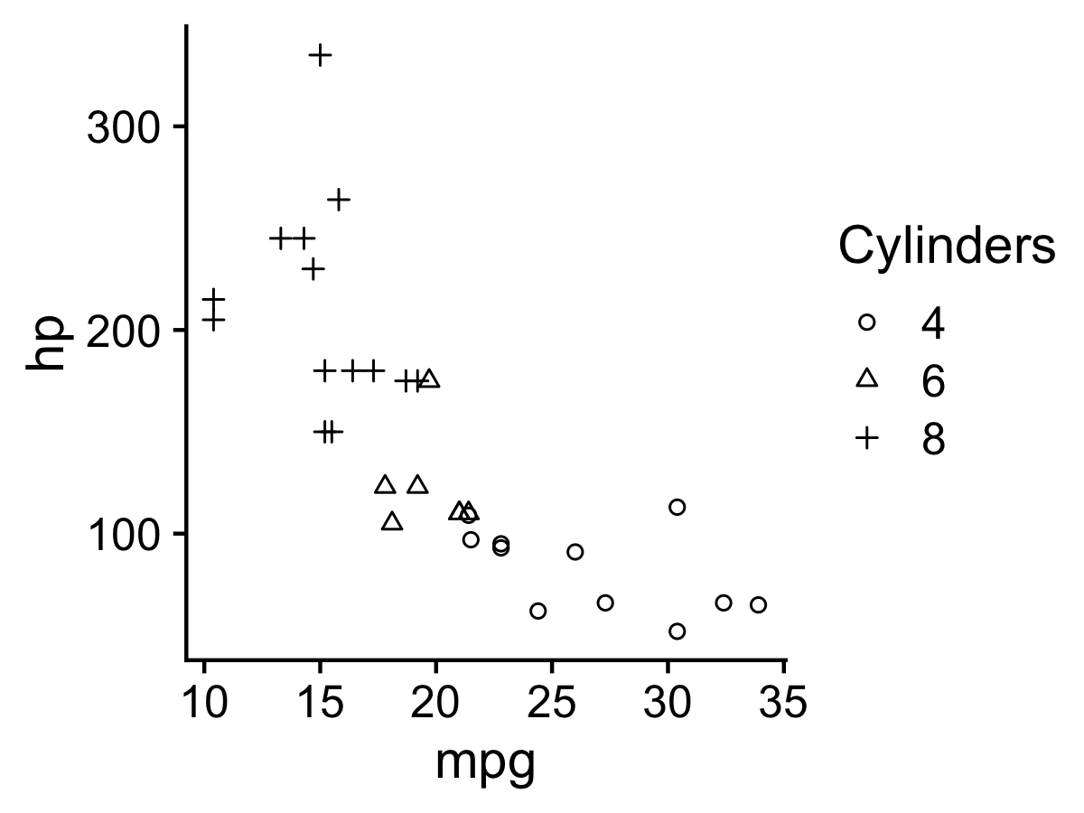
Law of similarity
We tend to see elements that are physically similar as part of the same object

Slide 66
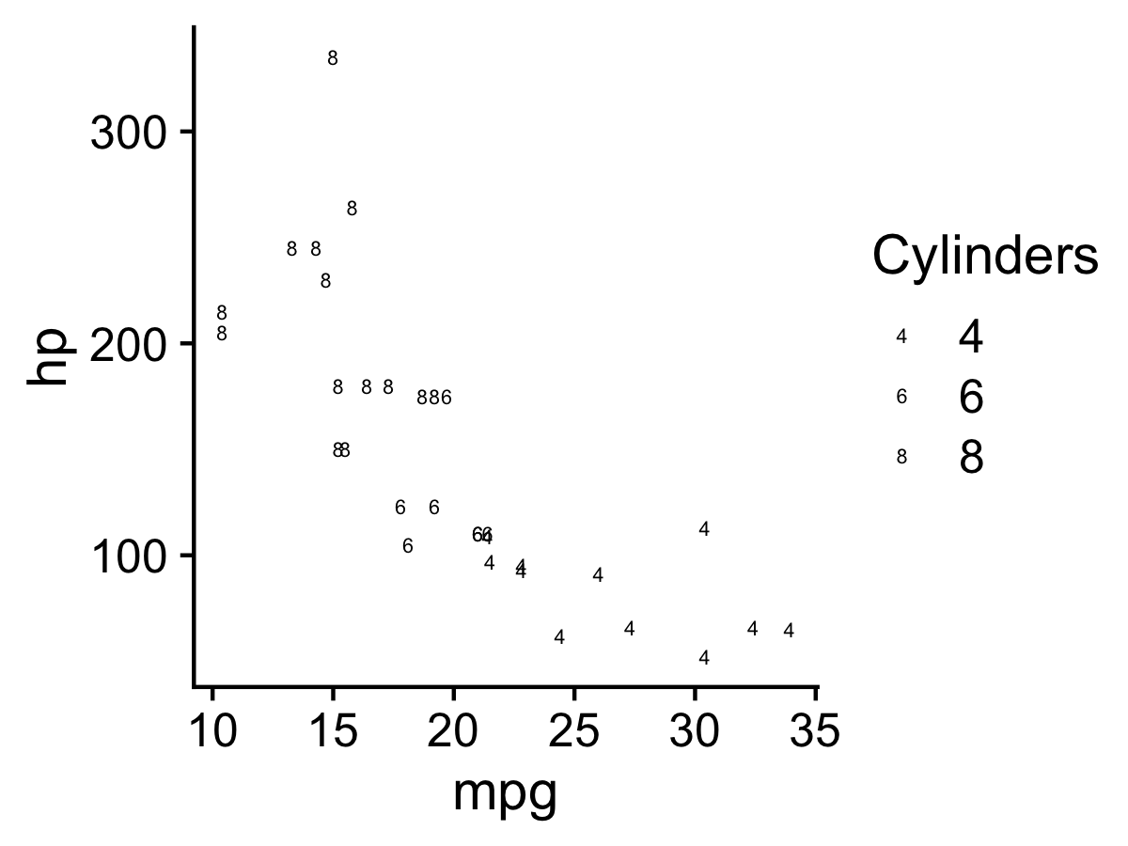
Law of similarity
We tend to see elements that are physically similar as part of the same object

Slide 67
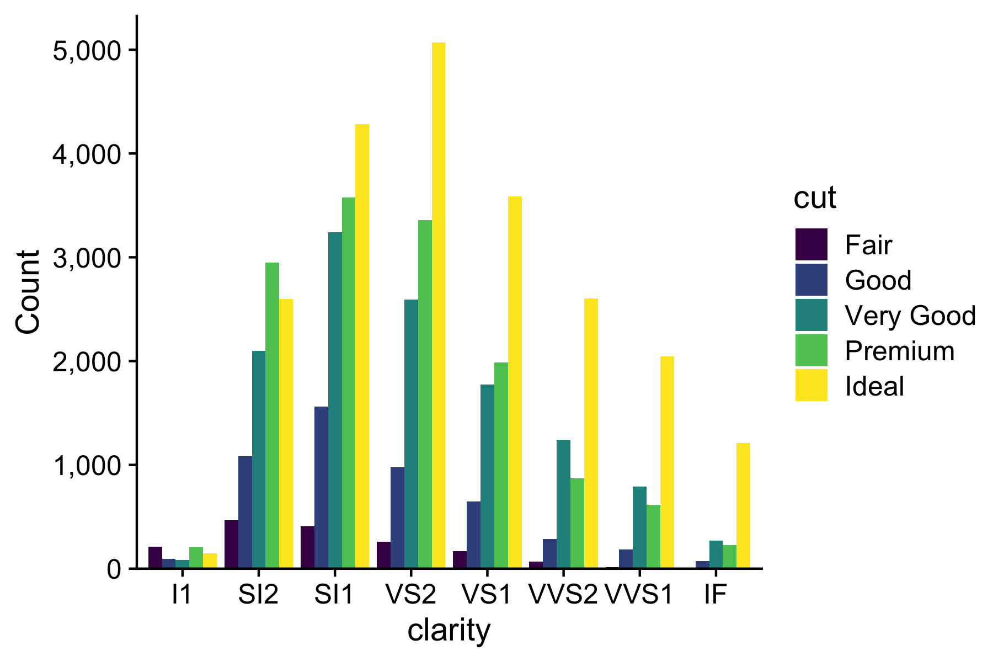
Law of proximity
We tend to see elements that are physically near each other as part of the same object

Slide 68
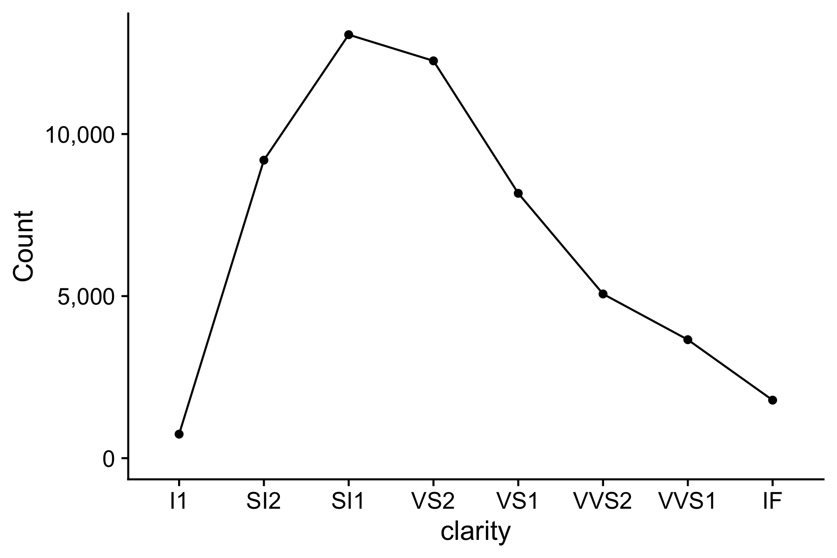
Law of proximity
We tend to see elements that are physically near each other as part of the same object
Notes:
Parallel coordinates plot

Slide 69
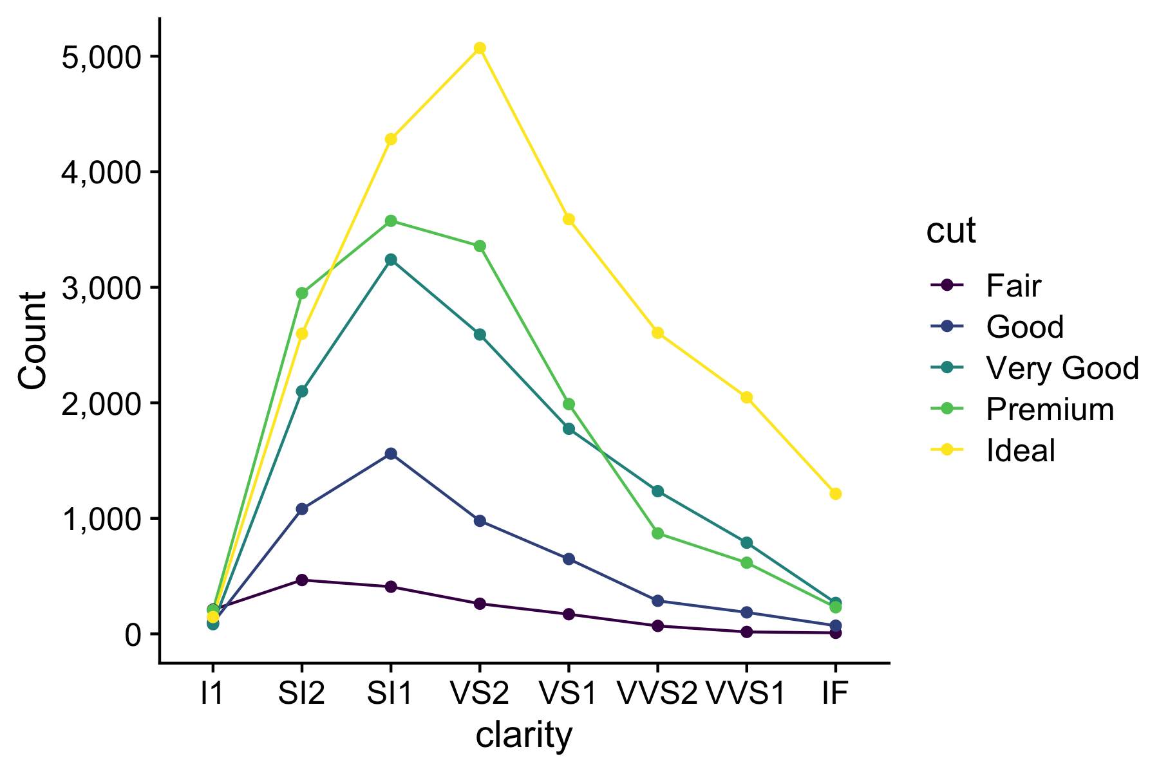
Law of proximity
We tend to see elements that are physically near each other as part of the same object
Notes:
Parallel coordinates plot

Slide 70
Cleveland’s three visual operations of pattern perception:
Estimation
Assembly
Detection
70

Slide 71
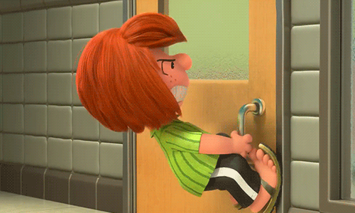

Slide 72

Norman door (n.):
A door where the design tells you to do the opposite of what you're actually supposed to do.
A door that gives the wrong signal and needs a sign to correct it.

Slide 73

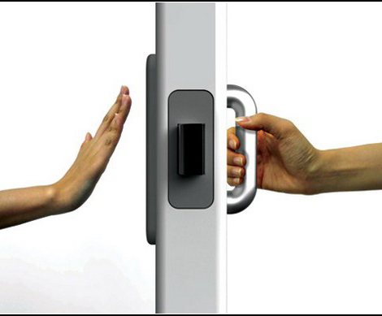
Norman door
Non-Norman door

Slide 74
Cleveland’s three visual operations of pattern perception:
Estimation
Assembly
Detection
Recognizing that a geometric object encodes a physical value
74

Slide 76
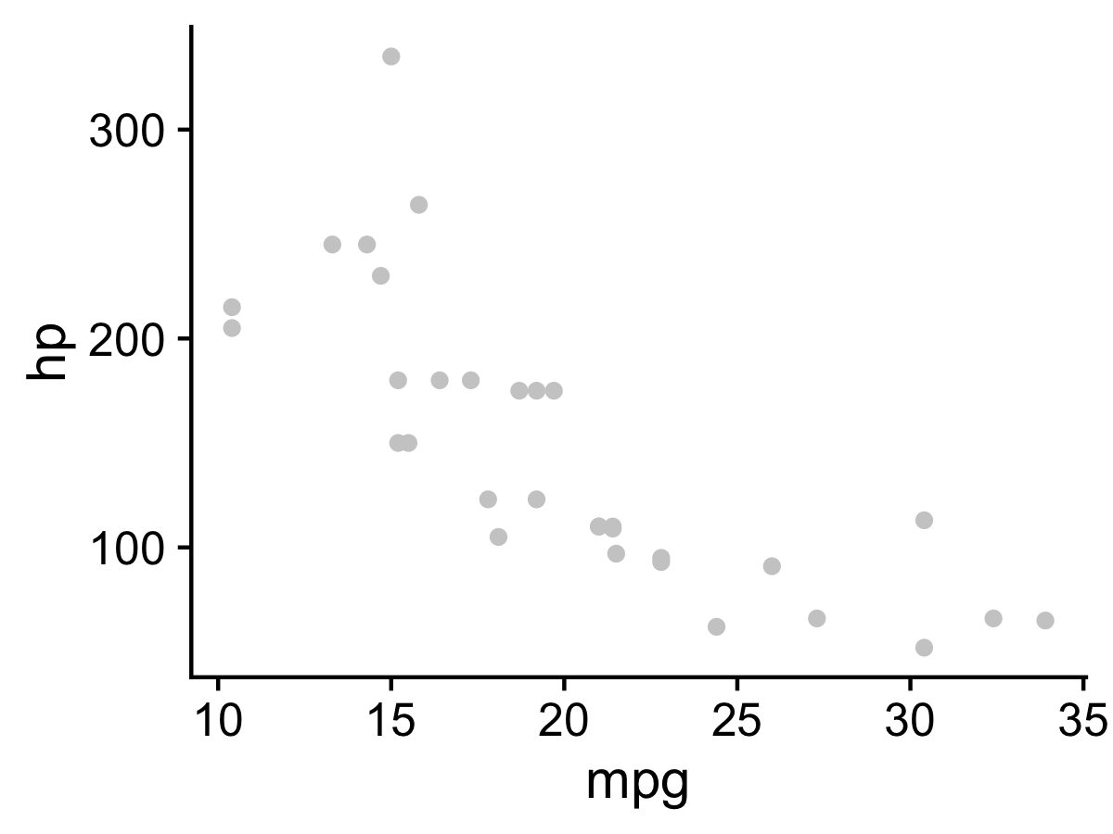

Slide 77


Slide 78
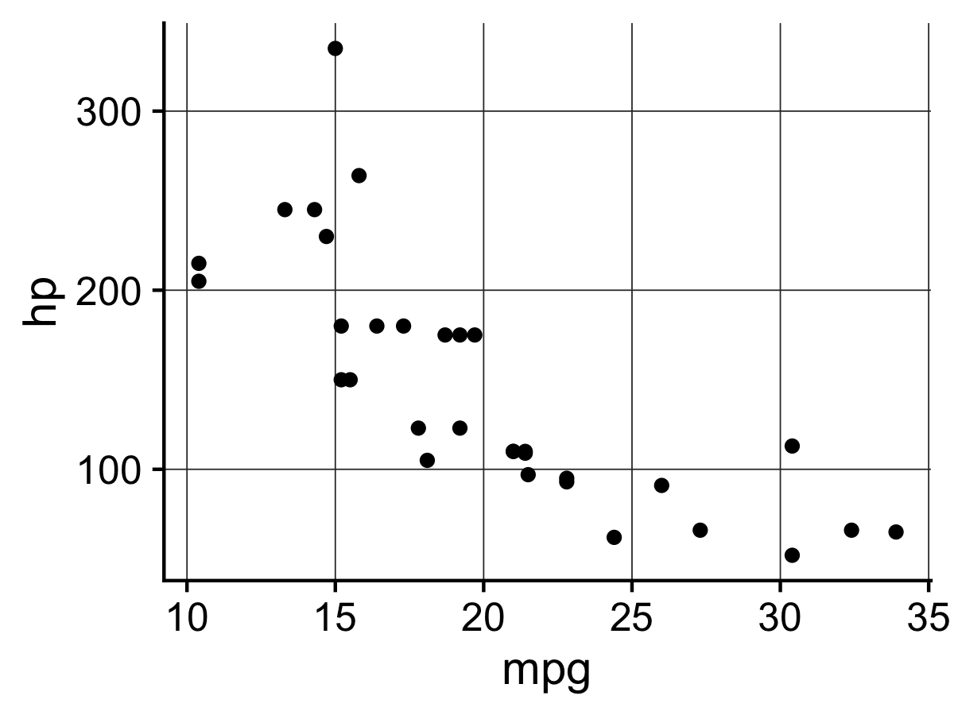

Slide 79
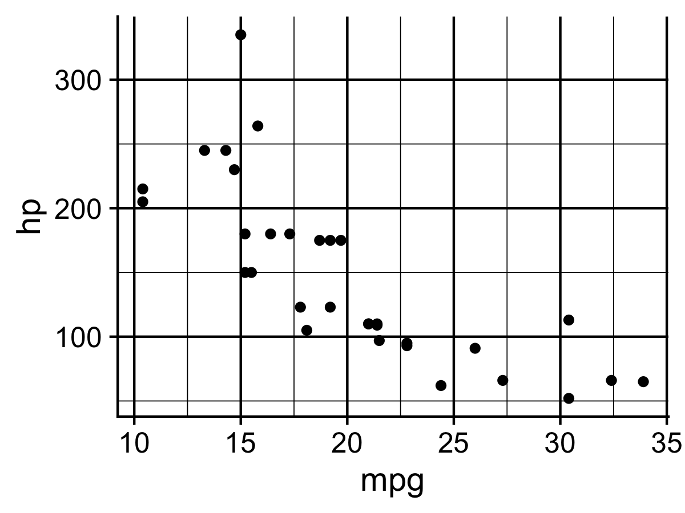

Slide 80
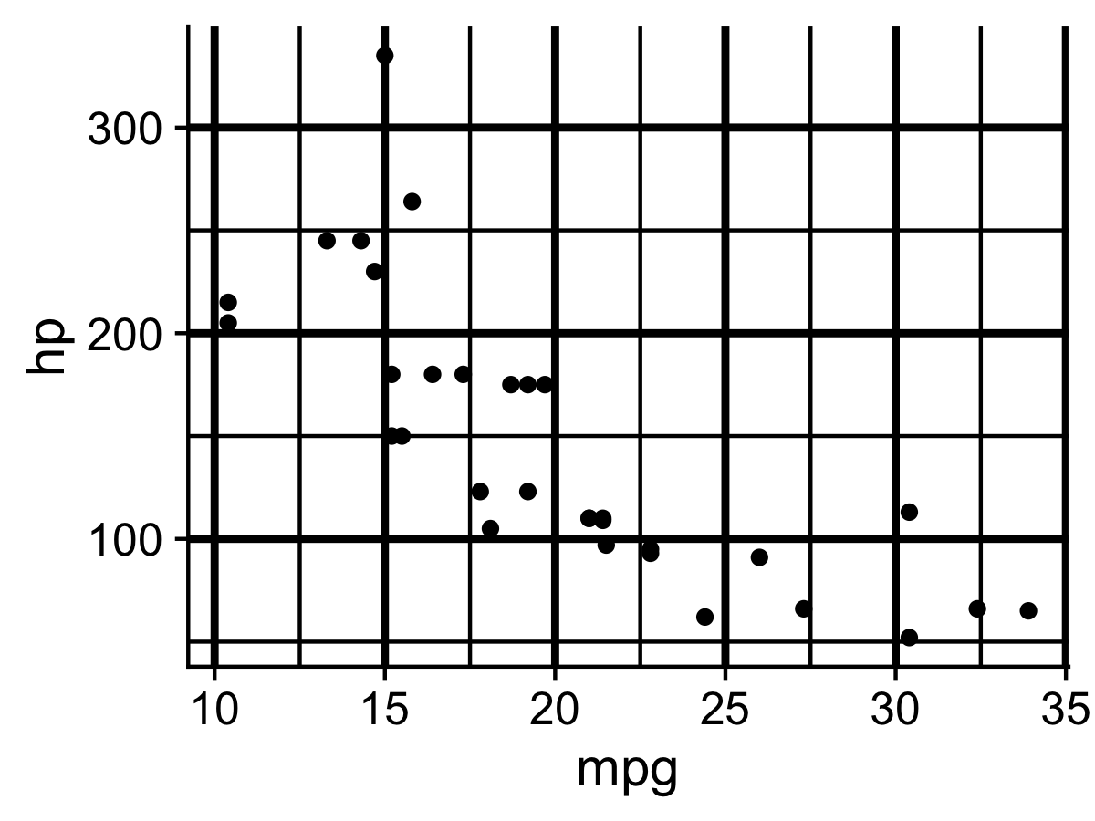

Slide 81
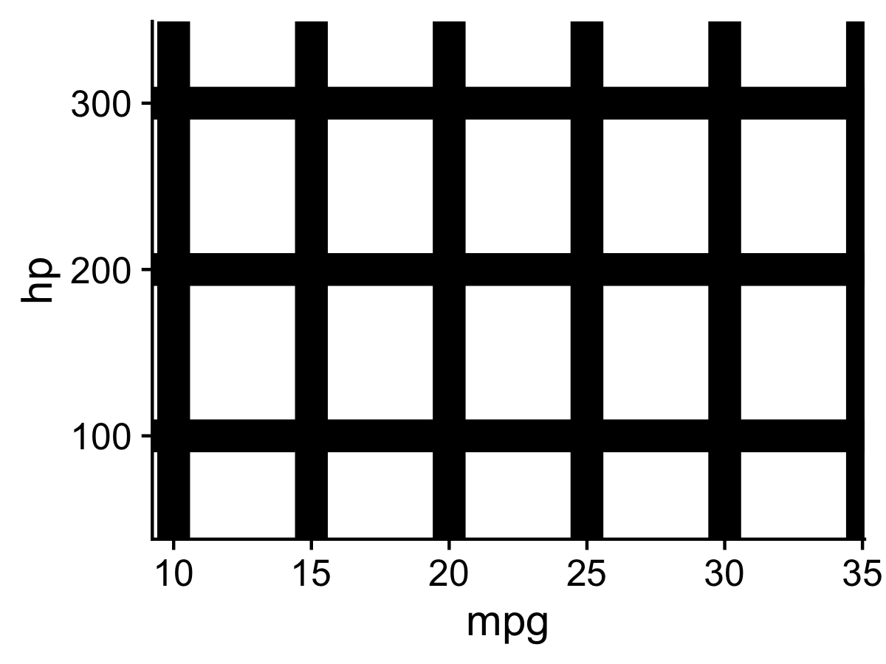
The Hermann Grid illusion

Slide 82
“Above all else, show the data” - Edward Tufte

Slide 83


Slide 84
10 lessons from research on visual perception
84

Slide 85
10 lessons from research on visual perception
Do remove chart chunk
Don’t make 3D plots*
Don’t lie
Don’t use pie charts for proportions*
Don’t stack bars*
Do rotate and sort categorical axes*
Do eliminate legends & directly label geoms*
Don’t use pattern fills
Don’t use red & green together
Do consider tables for small data sets
*most of the time
85

Slide 86
10 lessons from research on visual perception
Do remove chart chunk
Don’t make 3D plots*
Don’t lie
Don’t use pie charts for proportions*
Don’t stack bars*
Do rotate and sort categorical axes*
Do eliminate legends & directly label geoms*
Don’t use pattern fills
Don’t use red & green together
Do consider tables for small data sets
*most of the time
86

Slide 87


Figure 24.1: From Data Looks Better Naked by Darkhorse Analytics

Slide 88

Figure 24.1: From Data Looks Better Naked by Darkhorse Analytics

Slide 89
10 lessons from research on visual perception
Do remove chart chunk
Don’t make 3D plots*
Don’t lie
Don’t use pie charts for proportions*
Don’t stack bars*
Do rotate and sort categorical axes*
Do eliminate legends & directly label geoms*
Don’t use pattern fills
Don’t use red & green together
Do consider tables for small data sets
*most of the time
89

Slide 90
Don’t: 3D plots
1) Humans are not that good at
distinguishing 3D space
M.C. Escher (1898-1972)
Upstairs and Downstairs
(1960; lithography)
90
https://en.wikipedia.org/wiki/Penrose_stairs

Slide 91

Don’t: 3D plots
1) Humans are not that good at
distinguishing 3D space
Ink proportions != true proportions
M.C. Escher (1898-1972)
Upstairs and Downstairs
(1960; lithography)
91
https://en.wikipedia.org/wiki/Penrose_stairs

Slide 92

Don’t: 3D plots
2) Occlusion: geoms are obscured
92

Slide 93

A better alternative to 3D: faceting

Slide 94


Don’t: 3D plots
3) The third dimension distracts from the data
(this is what Tufte calls “chart junk”)

Slide 95
10 lessons from research on visual perception
Do remove chart chunk
Don’t make 3D plots*
Don’t lie
Don’t use pie charts for proportions*
Don’t stack bars*
Do rotate and sort categorical axes*
Do eliminate legends & directly label geoms*
Don’t use pattern fills
Don’t use red & green together
Do consider tables for small data sets
*most of the time
95

Slide 96






$$\frac{5.3 −0.6}{0.6}$$
Size of effect shown in graphic
Size of effect in data
$$7.83$$
“Lie Factor” =
=
=
= 14.8
$$\frac{27.5 −18}{18}$$
$$0.53$$
Edward Tufte (2001): The Visual Display of Quantitative Information, 2nd Edition, pg. 57-58
Notes:
Which is larger: North Central or South?

Slide 97

Do: Start bar charts at 0
Image from http://livingqlikview.com/the-9-worst-data-visualizations-ever-created/

Slide 98


Don’t: Cherry-pick your data
https://www.mediamatters.org/fox-news/fox-news-newest-dishonest-chart-immigration-enforcement

Slide 99

Make sure your plot makes sense
Image from http://livingqlikview.com/the-9-worst-data-visualizations-ever-created/

Slide 100
10 lessons from research on visual perception
Do remove chart chunk
Don’t make 3D plots*
Don’t lie
Don’t use pie charts for proportions*
Don’t stack bars*
Do rotate and sort categorical axes*
Do eliminate legends & directly label geoms*
Don’t use pattern fills
Don’t use red & green together
Do consider tables for small data sets
*most of the time
100

Slide 101

101
Notes:
Which is larger: North Central or South?

Slide 102

102
Notes:
You experience more information than is explicitly present in an image

Slide 103

Exceptions:
Small data
Simple fractions
If sums of parts matter
103

Slide 104
10 lessons from research on visual perception
Do remove chart chunk
Don’t make 3D plots*
Don’t lie
Don’t use pie charts for proportions*
Don’t stack bars*
Do rotate and sort categorical axes*
Do eliminate legends & directly label geoms*
Don’t use pattern fills
Don’t use red & green together
Do consider tables for small data sets
*most of the time
104

Slide 105

105

Slide 106
Notes:
Parallel coordinates plot

Slide 107

Exception: when you don’t need to compare the categories

Slide 108
10 lessons from research on visual perception
Do remove chart chunk
Don’t make 3D plots*
Don’t lie
Don’t use pie charts for proportions*
Don’t stack bars*
Do rotate and sort categorical axes*
Do eliminate legends & directly label geoms*
Don’t use pattern fills
Don’t use red & green together
Do consider tables for small data sets
*most of the time
108

Slide 109


109

Slide 110

Default ordering is almost always wrong
Ordered by alphabet
Ordered by count
110

Slide 111

Exception: Ordinal x-axis
111

Slide 112
10 lessons from research on visual perception
Do remove chart chunk
Don’t make 3D plots*
Don’t lie
Don’t use pie charts for proportions*
Don’t stack bars*
Do rotate and sort categorical axes*
Do eliminate legends & directly label geoms*
Don’t use pattern fills
Don’t use red & green together
Do consider tables for small data sets
*most of the time
112

Slide 113


113

Slide 114

Exception

Slide 115
10 lessons from research on visual perception
Do remove chart chunk
Don’t make 3D plots*
Don’t lie
Don’t use pie charts for proportions*
Don’t stack bars*
Do rotate and sort categorical axes*
Do eliminate legends & directly label geoms*
Don’t use pattern fills
Don’t use red & green together
Do consider tables for small data sets
*most of the time
115

Slide 116

Don’t use pattern fills

Slide 117


Slide 118
10 lessons from research on visual perception
Do remove chart chunk
Don’t make 3D plots*
Don’t lie
Don’t use pie charts for proportions*
Don’t stack bars*
Do rotate and sort categorical axes*
Do eliminate legends & directly label geoms*
Don’t use pattern fills
Don’t use red & green together
Do consider tables for small data sets
*most of the time
118

Slide 119


10% of males and 1% of females are color blind

Slide 120

Facets can be used to avoid color altogether

Slide 121
10 lessons from research on visual perception
Do remove chart chunk
Don’t make 3D plots*
Don’t lie
Don’t use pie charts for proportions*
Don’t stack bars*
Do rotate and sort categorical axes*
Do eliminate legends & directly label geoms*
Don’t use pattern fills
Don’t use red & green together
Do consider tables for small data sets
*most of the time
121

Slide 122


Slide 123


Slide 124
Who do you think did a better job in tonight’s debate?
 | Clinton | Trump
Among democrats | 99% | 1%
Among republicans | 53% | 47%

Slide 125
Two objectives of effective graphs:
Grab & direct attention (iconic memory)
Reduce processing demands (working memory)
Graph components:
Geoms:
points, lines, boxes, bars, etc.
Pre-attentive attributes:
position, color, shape, curvature, etc.
Non-data ink:
scales, grid lines, legend, labels, etc.
No chart junk!
Cleveland’s pattern recognition hierarchy:
Position on a common scale (best)
Position on non-aligned scales
Length
Angle
Area
Color saturation
Color hue (worst)
Cleveland’s three visual operations of pattern perception:
Estimation:
Discrimination X != Y
Ranking X > Y
Ratioing X / Y
Assembly:
The grouping of graphical elements
Prägnanz: We strongly prefer to interpret stimuli as regular, simple, and orderly
Detection:
Recognizing that a geometric object encodes a physical value
Above all else, show the data
10 lessons from research on visual perception:
Do remove chart chunk
Don’t make 3D plots*
Don’t lie
Don’t use pie charts for proportions*
Don’t stack bars*
Do rotate and sort categorical axes*
Do eliminate legends & directly label geoms*
Don’t use pattern fills
Don’t use red & green together
Do consider tables for small data sets
*most of the time

Slide 126
Your turn
1) Identify the following:
The geoms
The pre-attentive attributes
Where the graphic falls on Cleveland’s pattern recognition hierarchy
2) Identify the design rules that are broken (if any)
3) Suggest at least two improvements
126

Slide 127


127
https://people.howstuffworks.com/prison4.htm

Slide 128

128
Figure 1.4 in Healy, 2018

Slide 129


129
Figure 1.4 in Healy, 2018

Slide 130

130
http://www.wallstats.com/blog/down-the-rabbit-hole-of-the-pentagon-graphics-machine/

Slide 131

Ou et al., 2019 "Light-duty plug-in electric vehicles in China: An overview on the market and its comparisons to the United States"
131

Slide 132


132

Slide 133


133

Slide 134

134

Slide 135
Extra Slides

Slide 136


136

Slide 137
137

Slide 138

138
Notes:
Our brain perceives objects that are lighter at the top as concave

Slide 139
139
Notes:
Our brain perceives objects that are lighter at the top as concave

Slide 140

Do: Consider using graphs instead of tables
Helveston, J. P., Y. Liu, E. M. Feit, E. Fuchs, E. Klampﬂ, J.J. Michalek (2015) “Will subsidies drive electric vehicle adoption? Measuring consumer preferences in the U.S. and China.” Transportation Research Part A: Policy and Practice, 73, 96–112.

Slide 141

Gradient:
Change in continuous variable
Discrete:
Identify (a few) categorical variables

Slide 142

Tables:
Data organized into rows and columns
Graphs:
Visual representation of information in tables
Mammal | Body (kg) | Brain (g)
Arctic fox | 3.385 | 44.5
Owl monkey | 0.48 | 15.5
Mountain beaver | 1.35 | 8.1
Cow | 465 | 423
Grey wolf | 36.33 | 119.5
Goat | 27.66 | 115
Diagrams:
Visual representation of a process

Slide 143
Tables:
Data organized into rows and columns
Graphs:
Visual representation of information in tables
Mammal | Body (kg) | Brain (g)
Arctic fox | 3.385 | 44.5
Owl monkey | 0.48 | 15.5
Mountain beaver | 1.35 | 8.1
Cow | 465 | 423
Grey wolf | 36.33 | 119.5
Goat | 27.66 | 115
Diagrams:
Visual representation of process

Slide 144
“Visualizing data helps us think¹”
 | A |  | B |  | C |  | D
 | x | y | x | y | x | y | x | y
 | 10 | 8.04 | 10 | 9.14 | 10 | 7.46 | 8 | 6.58
 | 8 | 6.95 | 8 | 8.14 | 8 | 6.77 | 8 | 5.76
 | 13 | 7.58 | 13 | 8.74 | 13 | 12.74 | 8 | 7.71
 | 9 | 8.81 | 9 | 8.77 | 9 | 7.11 | 8 | 8.84
 | 11 | 8.33 | 11 | 9.26 | 11 | 7.81 | 8 | 8.47
 | 14 | 9.96 | 14 | 8.1 | 14 | 8.84 | 8 | 7.04
 | 6 | 7.24 | 6 | 6.13 | 6 | 6.08 | 8 | 5.25
 | 4 | 4.26 | 4 | 3.1 | 4 | 5.39 | 19 | 12.5
 | 12 | 10.84 | 12 | 9.13 | 12 | 8.15 | 8 | 5.56
 | 7 | 4.82 | 7 | 7.26 | 7 | 6.42 | 8 | 7.91
 | 5 | 5.68 | 5 | 4.74 | 5 | 5.73 | 8 | 6.89
Sum: | 99 | 82.51 | 99 | 82.51 | 99 | 82.5 | 99 | 82.51
Mean: | 9 | 7.5 | 9 | 7.5 | 9 | 7.5 | 9 | 7.5
St. Dev: | 3.3 | 2 | 3.3 | 2 | 3.3 | 2 | 3.3 | 2
1. Stephen Few (2009, pg. 6)

Slide 145

“Visualizing data helps us think¹”
1. Stephen Few (2009, pg. 6)

